Slide 1
Innovation and Market Leadership in a Technology Industry
Wilson Zehr, PhD, MBA
EOU Colloquium
November 12, 2020

Slide 2
What Do These Firms Have in Common?
1976
2004
1994
Tech Big 5
1998
1975
Did NOT Exist Before 1975!

Slide 3
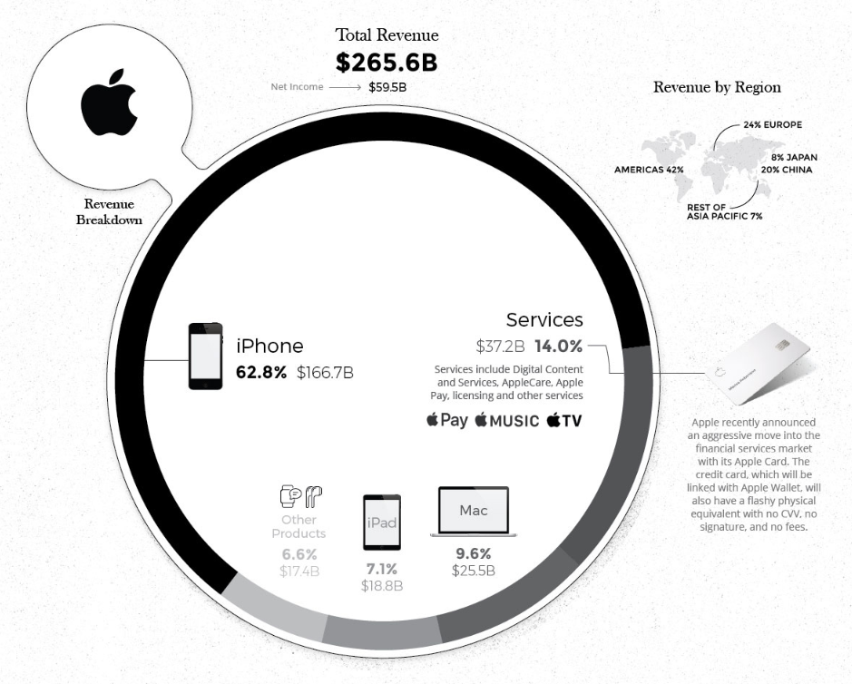
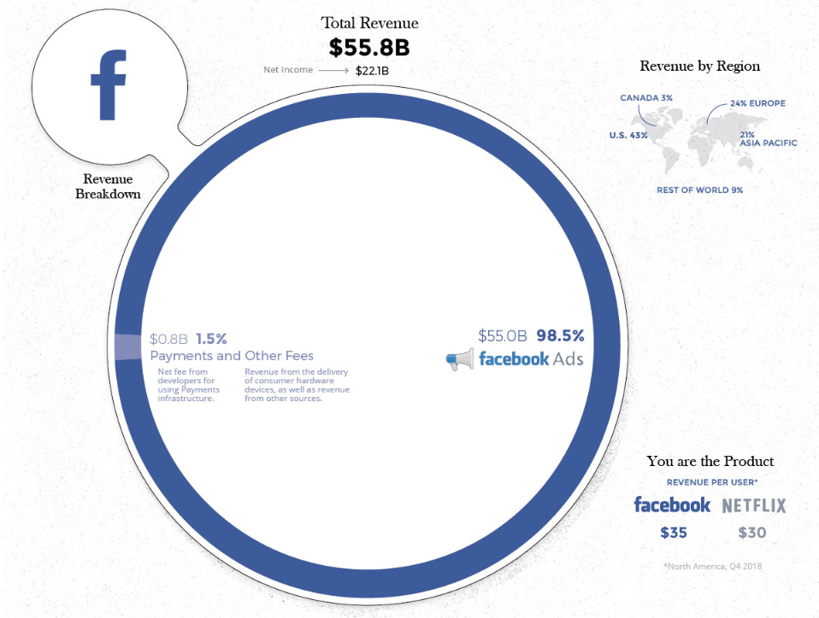
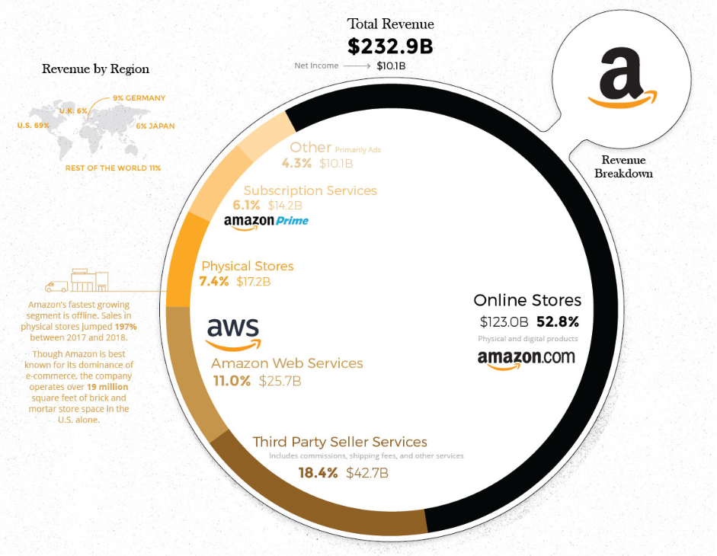
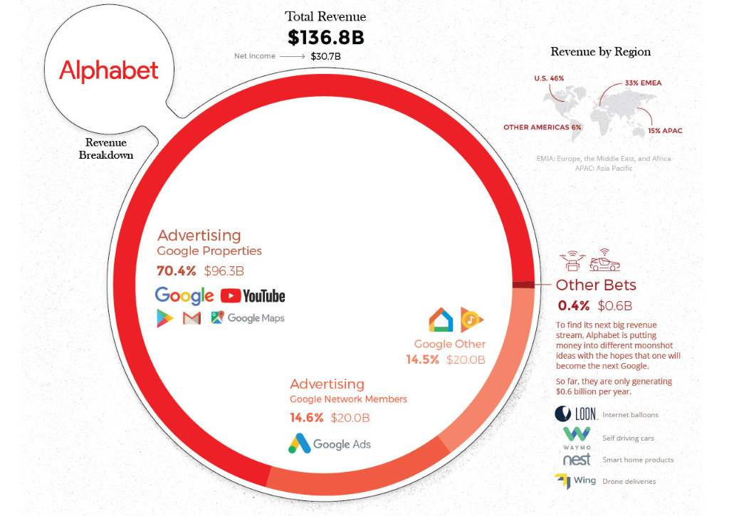
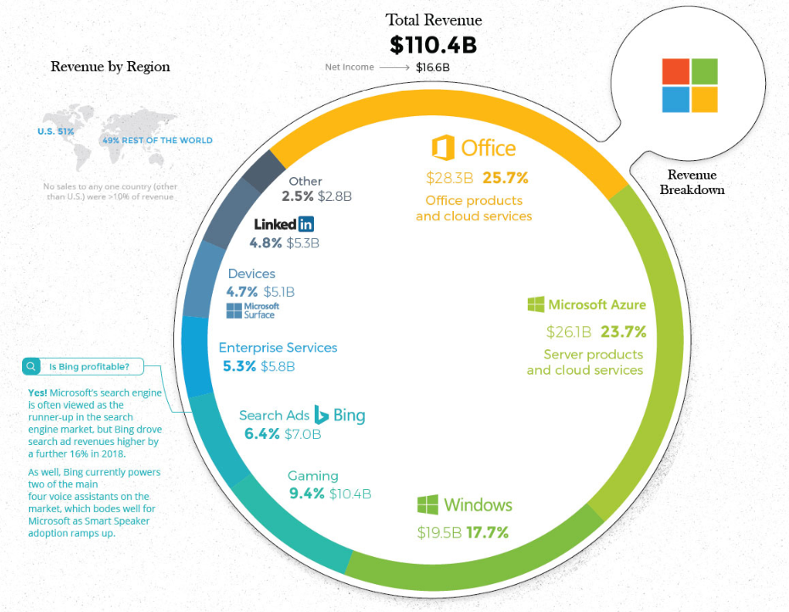
COMBINED
1 million+ employees
$802 billion revenue
$6.8 trillion market cap
Desjardins, J. (2019)
Innovation Responsible for 80% of U.S. Economic Growth Since World War II (Atkinson, 2011)
Creative Destruction (Schumpeter, 1934)

Slide 4
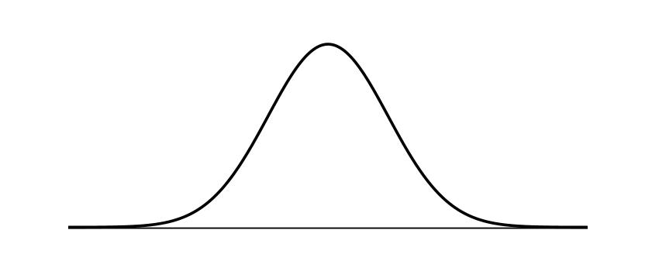
Conceptual Foundation
Rogers Diffusion Theory
100
75
Market Share %
50
25
Innovators
2.5%
early
adopters
13.5%
early
majority
34%
late
majority
34%
laggards
16%
0
t
Rogers (1962, 2003)
EOU Colloquium
November 12, 2020

Slide 5
Conceptual Foundation
Crossing the Chasm
the Chasm
Moore (1991)
No Guarantee….
EOU Colloquium
November 12, 2020

Slide 6
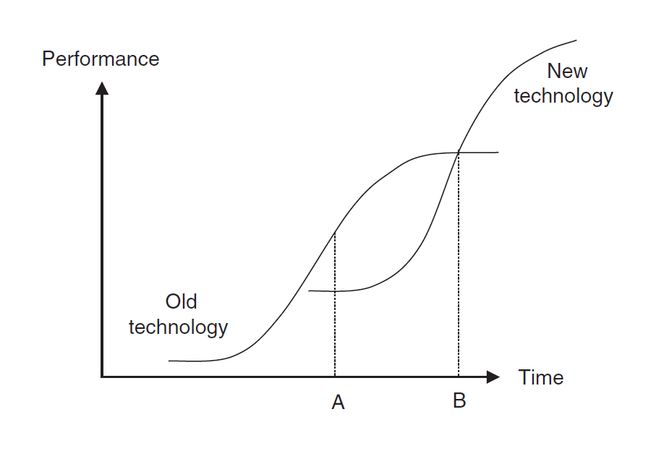
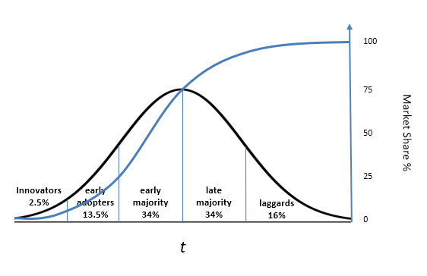
Conceptual Foundation
Incremental vs. Disruptive Innovation
incremental
innovation
disruptive
innovation
t
Rogers (1962, 2003)
Christensen (1997)
dominant design
competing designs

Slide 7
Conceptual Foundation
A-U Model
dominant
design
Forms of Innovation
product
process
marketing
organizational
business model
other frameworks…
EOU Colloquium
November 12, 2020

Slide 8
Problem Statement
The general problem is that there does not appear to be consensus on the form(s) that non-technological innovation can take.
The specific problem is that the A-U model, which guides innovators and researchers (Teece, 1986; Akiike, 2013), does not include forms of non-technological innovation that are generally accepted by experts (OECD, 2018).
These new forms of innovation have been shown to produce returns that are four times larger, and far more sustainable, than traditional product/process innovation (Lindgart, Reeves, Stalk, & Deimler, 2009).
EOU Colloquium
November 12, 2020

Slide 9
Research Question
What is the consensus of an expert panel of innovators and researchers on the form(s) of innovation that were used by competitors to establish market leadership over the historical lifecycle of a technology industry?
EOU Colloquium
November 12, 2020

Slide 10
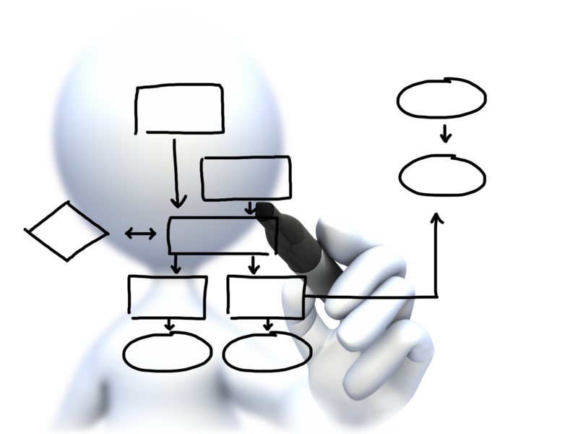
Research Process
Method & Design
Qualitative e-Delphi process, using an analytical hierarchical process (AHP) decision model, based on 45 years of historical industry results (1975 - 2020).
Build consensus on market share leaders, forms of innovation considered, and form used by each market share leader
Saaty (1980)
Linstone & Turoff (1975)
Dalkey & Helmer (1963)

Slide 11
Research Process
Expert Panel
Panel 20+ experts (Ludwig, 1997; Hsu & Sandford, 2007)
Experts in the technology industry with an understanding of the evolution of the PC industry
Purposeful selection based on response to an electronic LinkedIn invitation
LinkedIn profiles reviewed for industry experience
EOU Colloquium
November 12, 2020

Slide 12
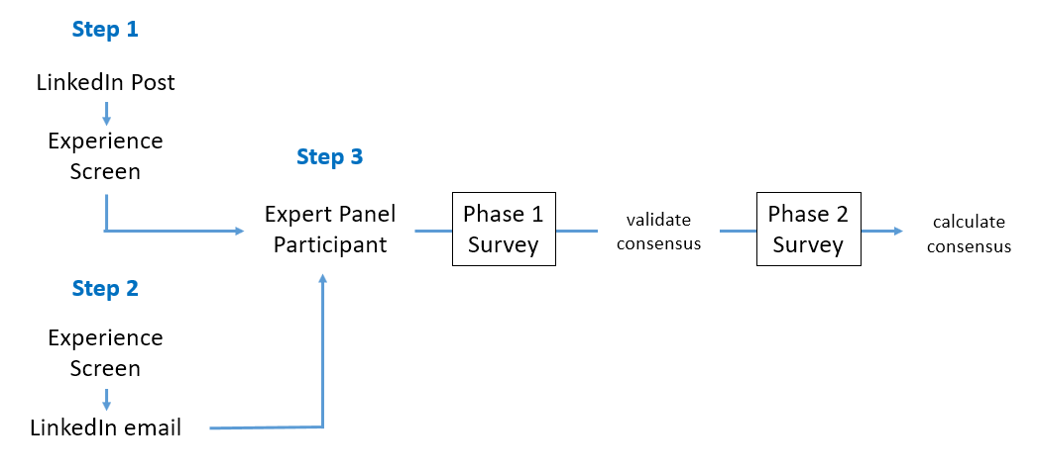
Expert Panel Recruiting
Expert Panel
LinkedIn: 660 million users, 200 countries
50% College educated Americans
2,613 1st level connections
1.4 million 2nd level connections
Diverse industries/segments
20+ years in technology
Tran (2020)
Zhang & Vucetic (2016)
Huang, Tunkelang, & Karahalios (2014)
Unkelos-Shpigel, Sherman, & Hadar (2015)

Slide 13
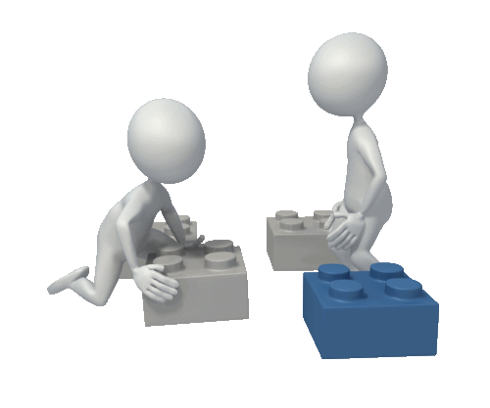
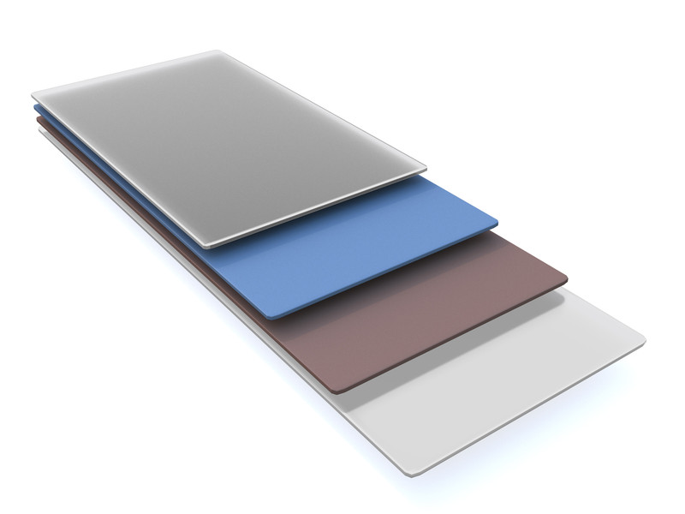
Research Process
US PC Data Collection
45 years U.S. PC market share data
Multiple data sources/sets
U.S. PC market share 1980 – 1982 (Steffens, 1994)
U.S. PC market share 1980 – 1998 (Narayandas & Rangan, 1996; Rivken, Porter, & Nabavi, 1999)
U.S. PC market share 1975 – 1981 (Reimer, 2005)
U.S PC market share 1994 – 2008 (Rivken, 2010)
U.S. PC market share 2009 – 2015 (International Data Corporation, 2016)
U.S. PC market share 2013 – 2010 (Gartner Group, 2020a)
Worldwide PC market share 2013 – 2020 (Gartner Group, 2020b)
Cross-validated, filled, and smoothed

Slide 14
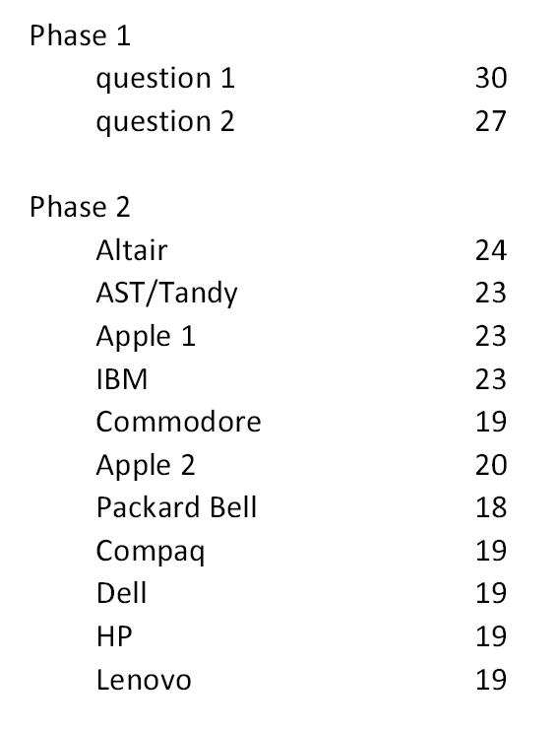
Research Process
Participation Rates
30 “verified” experts
Two rounds
Phase 1: Forms of innovation
Phase 2: Market leaders
Calculate consensus
Study target 20
Phase 1: 30 experts
Phase 2: 24 start => 19 end
Question fatigue vs. round fatigue
Independent judgments
Participation

Slide 15
Research Process
Phase 1 Responses
Forms of Innovation
Product Process
Marketing Organizational
Consistent with 3rd Edition Oslow Manual (OECD, 2005)

Slide 16
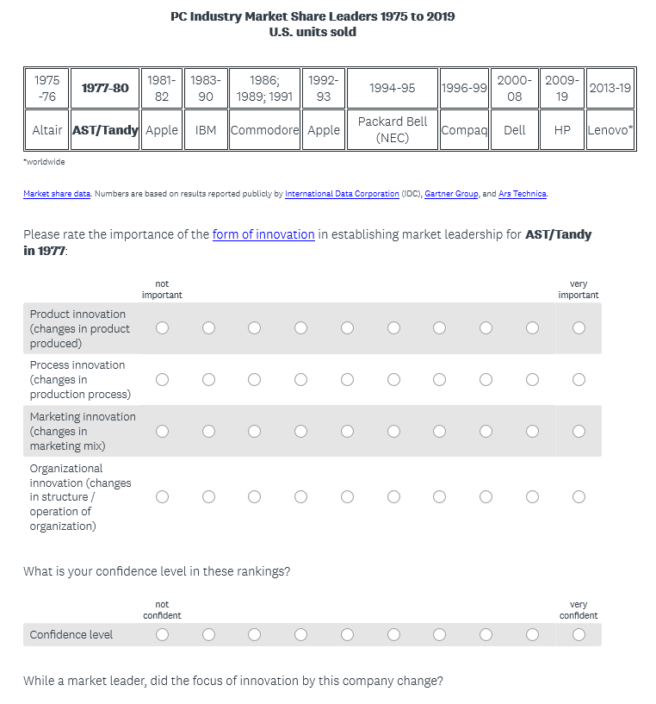
Research Process
Phase 2 Responses
a₁
a₂
a₃
Likert Scale 1..9
Saaty Scale 1..9 (pairwise)
pairwise
a₄
a_{ij} = |judgment_{ik} – judgment_{jk}| + 1
ordinal scale

Slide 17
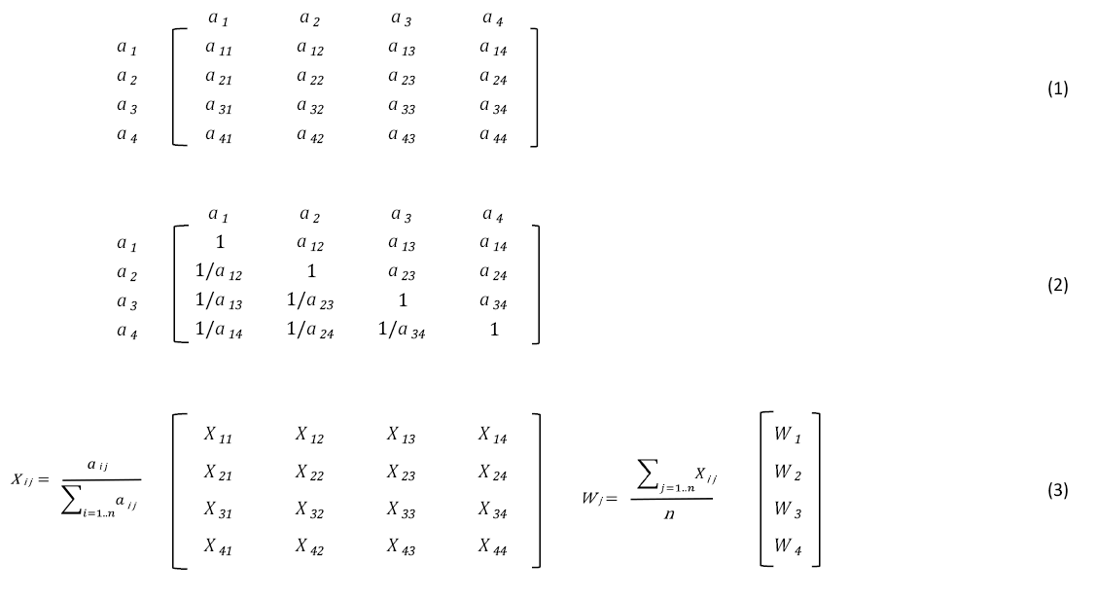
Research Process
Calculate Priority Matrix (AHP)
a₁ to a₂, a₁ to a₃, a₁ to a₄
a₂ to a₃, a₂ to a₄
a₃ to a₄
pairwise
Consistency Index (4)
Saaty (1980)
Bunruamkaew (2012)

Slide 18
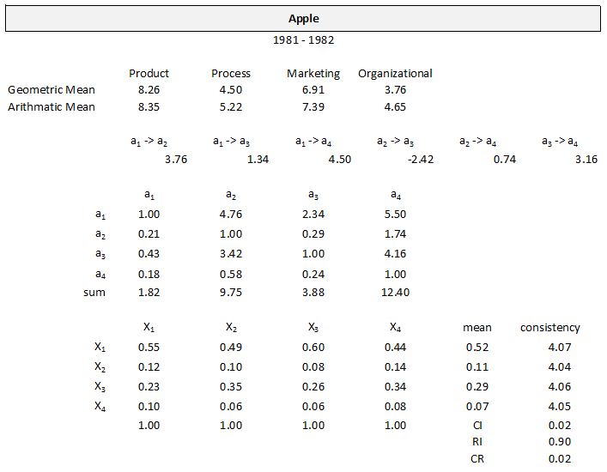
Research Process
Sample Matrix
4 forms innovation
11 market leaders
45 years

Slide 19
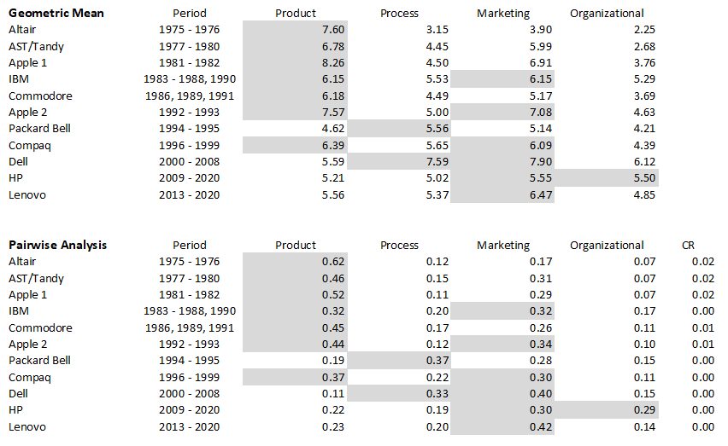
Research Process
Summary Results
ratio scale
AIJ vs. AIP
Forman & Peniwati (1997)

Slide 20
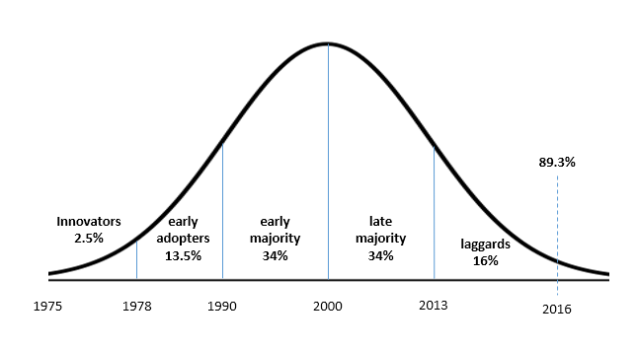
Research Process
US PC Market Diffusion
3
12
10
13
2011
2025
U.S. Census Bureau (2014, 2018)

Slide 21
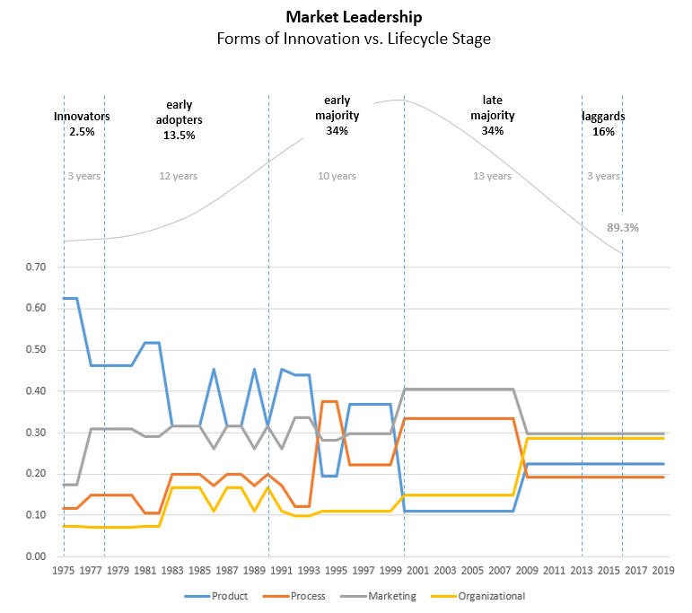
Research Process
Results vs Lifecyle Stage
product (technology) trends down
marketing trends up
organizational trends up
process trends up, then falls

Slide 22
Research Process
Results vs Lifecyle Stage
market segmentation
business, consumer, education…
peak
ratio scale
IBM
PB
Altair
Tandy
Apple
IBM
Commodore
Apple
Compaq
Dell
HP
PB
Compaq
Dell
HP
Altair
Tandy
Apple
Commodore
Apple
Confidence 5+
71%
68%
83%
73%
56%
59%
76%
74%
83%
76%
Netscape

Slide 23
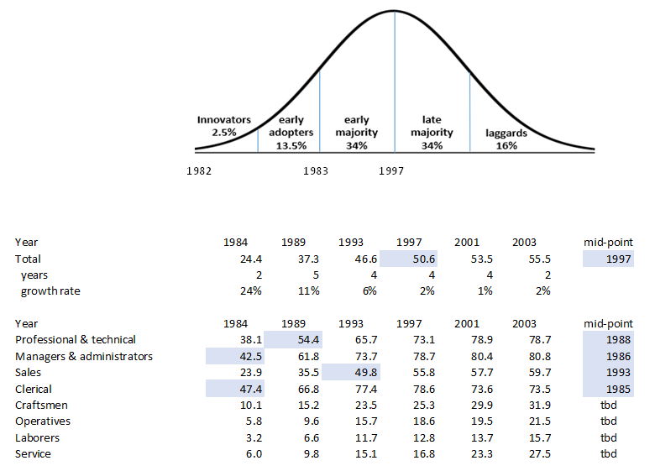
Research Process
Business Market Diffusion
distribution is not normal
1
14
mid-point difference(s)
2011
2025
Bureau of Labor Statistics (2005), Friedberg (2003), Hipple & Kosanovich (2003)

Slide 24
Research Findings
Product, process, marketing, organizational innovation
AHP decision model shows promise
Reduce e-Delphi rounds
Likert to pairwise
Reduce comparisons [N(N-1)/2 vs. N]
Eliminate inconsistency [a > b & b > c => a > c]
Zero value case [completely unimportant]
Ratio results
Diffusion not “normal” in sub-segments
Product -> process innovation early-mid cycle (A-U model)
Marketing/organizational innovation mid-late stage

Slide 25
Research Findings
Expanded Model
high
diminishing
marginal value
diminishing
marginal effectiveness
product (technological)
innovation
rate of innovation
process
innovation
marketing
innovation
lower price vs.
higher margin
organizational
innovation
low
t
A-U Model
Expanded A-U Model
Mantovani (2006)
Christensen (1997)
Utterback (1994)
Utterback & Abernathy (1975)
Innovation vs. market leadership

Slide 26
Recommendations
Utterback & Abernathy (1975) based on 567 commercial innovations, 5 industries, 120 firms. Expand research to additional products and industries to validate.
Examine all competitors to identify what forms of innovation did not result in market leadership
Explore Rogers (1962, 2003) model within sub-segments and specific demographic attributes in complex markets

Slide 27
Recommendations
Standardize definition of business model innovation and test against organizational innovation
Create tool to traverse social networks to measure demographic diversity and research project fit (target)
Expand testing of Likert-pairwise technique

Slide 28
Questions

Slide 29
More to come…
Special Thanks
Holly Chason
Robert Butler
John Thurber
Peter Maille
Gary Keller

Slide 30
References
Akiike, A. (2013). Where is Abernathy and Utterback model? Annals of Business Administrative Science, 12(5), 225-236. doi:10.7880/abas.12.225
Atkinson, R. (2011). U.S. competitiveness facts. U.S. Competitiveness: A New Conversation with New Opportunities, March 2011. Washington, DC: Information Technology and Innovation Foundation. Retrieved from http://www.itif.org
Bunruamkaew, K. (2012). How to do AHP analysis in Excel. University of Tsukuba, Graduate School of Life and Environmental Sciences, Division of Spatial Information Science.
Bureau of Labor Statistics. (2005). Computer and internet use at work in 2003. Washington, D.C.: U.S. Department of Labor. Retrieved from http://www.bls.gov/cps/
Christensen, C. (1997). The innovator’s dilemma: When new technologies cause great firms to fail. Boston, MA: Harvard Business School Press.
Desjardins, J. (2019). How Tech Giants Make Their Billions [Infographic]. Visual Capitalist. Retrieved from https://www.visualcapitalist.com/how-tech-giants-make-billions/
Donohoe, H. M., Stellefson, M., & Tennant, B. (2012). Advantages and limitations of the e-Delphi technique. American Journal of Health Education, 43, 38-46. doi:10.1080/19325037.2012.10599216.
Fagerberg, J. (2018). Innovation: A guide to the literature. Innovation, Economic Development and Policy (3-28). doi:10.4337/9781788110266.00007
Forman, E., & Peniwati, K. (1997). Aggregating individual judgments and priorities with the analytic hierarchy process. European Journal of Operational Research, 108(1), 165–169. doi:10.1016/s0377-2217(97)00244-0
Friedberg, L. (2003). The Impact of Technological Change on Older Workers: Evidence from Data on Computer Use. ILR Review, 56(3), 511–529. doi:10.1177/001979390305600309
Gartner Group. (2020a). Personal computer (PCs) unit shipments in the United States by vendor from 1Q'13 to 4Q'19 (in millions) [Spreadsheet]. In Statista. Retrieved February 01, 2020, from https://www-statista-com.access.library.eou.edu/statistics/816356/unit-shipments-pcs-united-states-vendor/

Slide 31
References
Gartner Group. (2020b). Personal computer (PC) unit shipments worldwide from 2006 to 2019, by vendor (in millions) [Spreadsheet]. In Statista. Retrieved February 01, 2020, from https://www-statista-com.access.library.eou.edu/statistics/267023/global-pc-shipments-since-2006-by-vendor/
Hipple, S., & Kosanovich, K. (2003). Computer and Internet use at work in 2001. Monthly Labor Review, 126(26). Washington, D.C.: U.S. Department of Labor. Retrieved from https://www.bls.gov/opub/mlr/
Hsu, C., & Sandford, B. (2007). The Delphi technique: Making sense of consensus. Practical Assessment, Research & Evaluation, 12(10), 173-192. doi:10.4018/978-1-4666-0074-4.ch011
Huang, W., Tunkelang, D., & Karahalios, K. (2014). The role of network distance in LinkedIn people search. Proceedings of the 37th International ACM SIGIR Conference on Research & Development in Information Retrieval - SIGIR ’14. doi:10.1145/2600428.2609461
International Data Corporation. (2016). Personal computer (PC) shipments in the U.S. from 2009 to 2015, by vendor (in million units) [Spreadsheet]. In Statista. Retrieved February 08, 2020, from https://www-statista-com.access.library.eou.edu/statistics/273682/us-pc-shipments-since-2009-by-vendor/
Kallas, Z. (2011). Butchers’ preferences for rabbit meat; AHP pairwise comparisons versus a Likert scale valuation. In Proceedings of the International Symposium on the Analytic Hierarchy Process for Multicriteria Decision Making (pp. 1-6).
Kannan, V. (2020). Canalys: Demand surges but PC shipments fall 8% due to supply chain hit by COVID-19. Portland, OR: Canalys. Retrieved from https://www.canalys.com/newsroom/global-pc-market-Q12020-COVID19
Lindgart, Z., Reeves, M., Stalk, G., & Deimler, M. (2009). Business model innovation – When the game gets tough, change the game. Boston, MA: Boston Consulting Group. doi:10.1002/9781119204084.ch40
Linstone, H. A., & Turoff, M. (1975). The Delphi method: techniques and applications. Reading, MA: Addison-Wesley Publishing Company.
Ludwig, B. (1997). Predicting the future: Have you considered using the Delphi methodology? Journal of Extension, 35 (5), 1-4. Retrieved from http://www.joe.org/joe/1997october/

Slide 32
References
Medrano, N., & Olarte-Pascual, C. (2016). An empirical approach to marketing innovation in small and medium retailers: An application to the Spanish sector. Contemporary Economics, Vol 10 (3), 205-216. doi:10.5709/ce.1897-9254.210
Moore, G. (1991). Crossing the chasm. New York, NY: Harper Collins Publishers.
Narayandas, D., & Rangan, K. (1996). Dell Computer Corporation. HBS No. 9-596-058. Boston, MA: Harvard Business School Publishing. Retrieved from https://www.hbr.org
OECD. (2005). Oslo manual: Guidelines for collecting and interpreting innovation data, 3rd edition. Paris, France: OECD Publishing. doi:10.1787/9789264013100-en
OECD. (2018). Oslo manual 2018: Guidelines for collecting, reporting and using data on innovation, 4th edition. Paris, France: OECD Publishing. doi:10.1787/9789264304604-en
Unkelos-Shpigel, N., Sherman, S., & Hadar, I. (2015). Finding the Missing Link to Industry: LinkedIn Professional Groups as Facilitators of Empirical Research. 2015 IEEE/ACM 3rd International Workshop on Conducting Empirical Studies in Industry. doi:10.1109/cesi.2015.14
Osterwalder, A., & Pigneur, Y. (2010). Business model generation. Hoboken, NJ: John Wiley & Sons.
Porter, M. (1985). Competitive Advantage. New York, NY: Free Press.
Reimer, J. (2005). Total share: 30 years of personal computer market share figures [Data file]. ARS Technica. Retrieved from http://jeremyreimer.com/
Richter, F. (2017). Five years past peak PC. New York, NY: Statista. Retrieved from https://www.statista.com/chart/5241/global-pc-shipments-since-2008/
Rivken, J., Porter, M., & Nabavi, F. (1999). Matching Dell. HBS No. 9-799-158. Boston, MA: Harvard Business School Publishing. Retrieved from https://www.hbr.org
Rivken, J. (2010). Revitalizing Dell. HBS No. 9-710-442. Boston, MA: Harvard Business School Publishing. Retrieved from https://www.hbr.org
Rogers, E. (1962). Diffusion of innovations (1st ed.). New York, NY: Free Press.
Rogers, E. (2003). Diffusion of innovations (5th ed.). New York, NY: Free Press.

Slide 33
References
Saaty, T. (1980). The analytic hierarchy process: Planning, priority setting, resource allocation. New York, NY: McGraw Hill.
Schumpeter, J. (1934). The theory of economic development: an inquiry into profits, capital, credit, interest and the business cycle. Boston, MA: Harvard University Press.
Schumpeter, J. (1942). Creative destruction. Capitalism, socialism and democracy, 825, 82-85. New York, NY: Harper.
Steffens, J. (1994). Computer industry forecasts and newgames: Strategic competition in the pc revolution. New York, NY: Pergamon Press.
Teece, D. (1986). Profiting from technological innovation. Research Policy, 15(6), 285–306. doi:10.1016/0048-7333(86)90027-2
Tran, T. (2020). Top LinkedIn demographics that matter to social media marketers. Hootsuite. Retrieved from https://blog.hootsuite.com/linkedin-demographics-for-business/
U.S. Census Bureau. (2014). Computer and internet use tables [Data file]. Retrieved from https://www.census.gov/topics/population/computer-internet/data/tables.html
U.S. Census Bureau. (2018). Percentage of households in the United States with a computer at home from 1984 to 2016 [Graph/Spreadsheet]. In Statista. Retrieved February 01, 2020, from https://www-statista-com.access.library.eou.edu/statistics/214641/household-adoption-rate-of-computer-in-the-us-since-1997/
Utterback, J. M. (1994). Mastering the dynamics of innovation. Boston, MA: Harvard Business School Press.
Utterback, J. M., & Abernathy, W. (1975). A dynamic model of process and product innovation. Omega, The International Journal of Management Science, 3(6), 639–656. doi:10.1016/0305-0483(75)90068-7
Von Hippel, E. (2005). Democratizing innovation. Cambridge, MA: MIT University Press.
Zhang, S., & Vucetic, S. (2016). Sampling Bias in LinkedIn. Proceedings of the 25th International Conference Companion on World Wide Web - WWW ’16 Companion. doi:10.1145/2872518.2889357

Slide 34
Backup

Slide 35
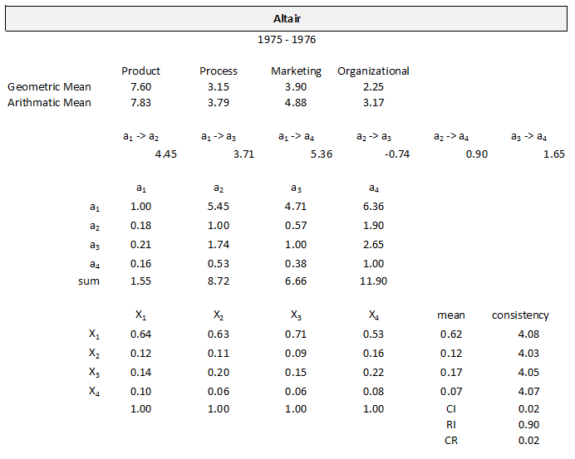
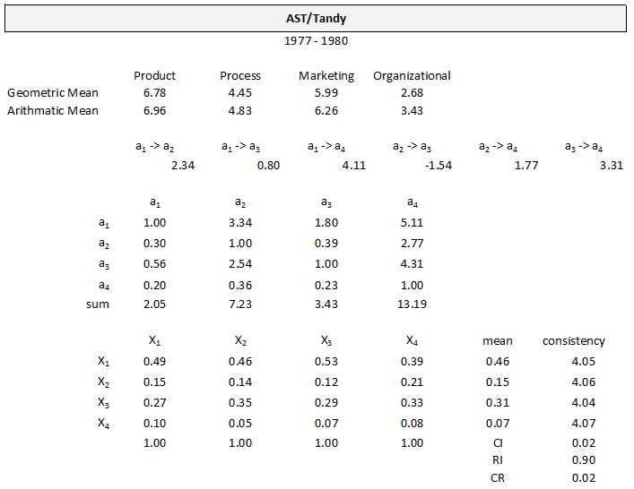
AHP Results

Slide 36
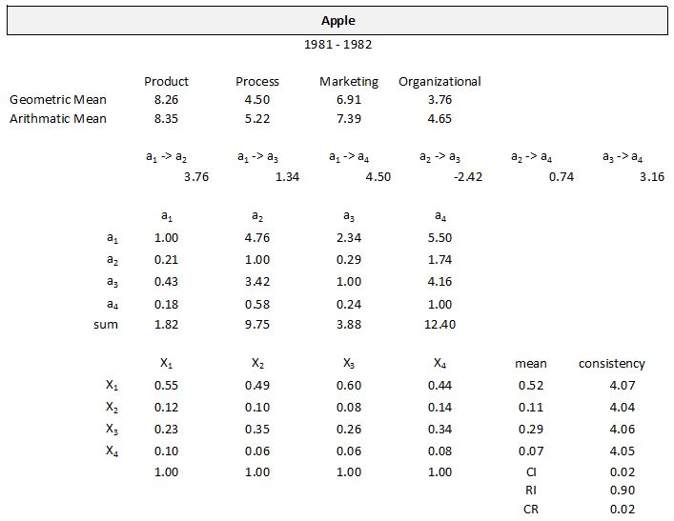
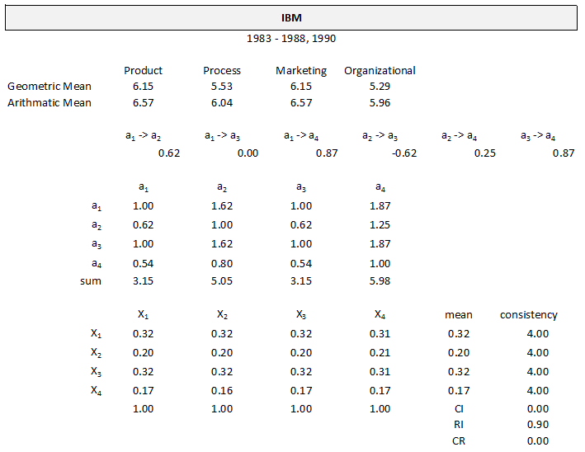
AHP Results

Slide 37
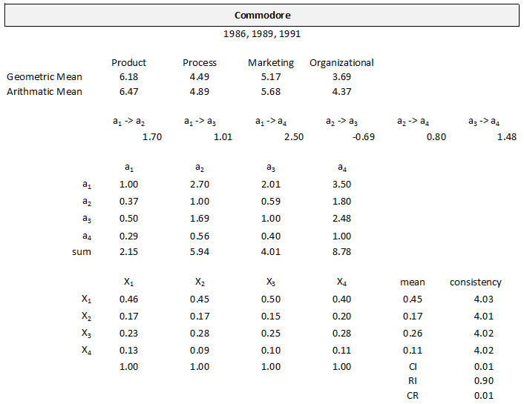
AHP Results

Slide 38
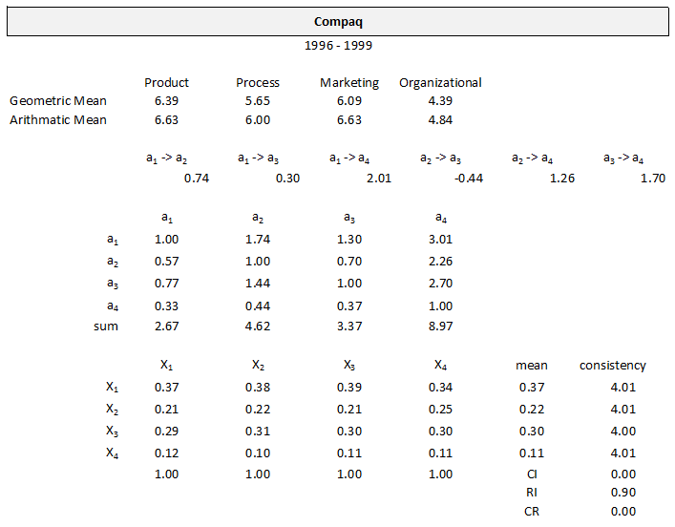
AHP Results

Slide 39
AHP Results

Slide 40
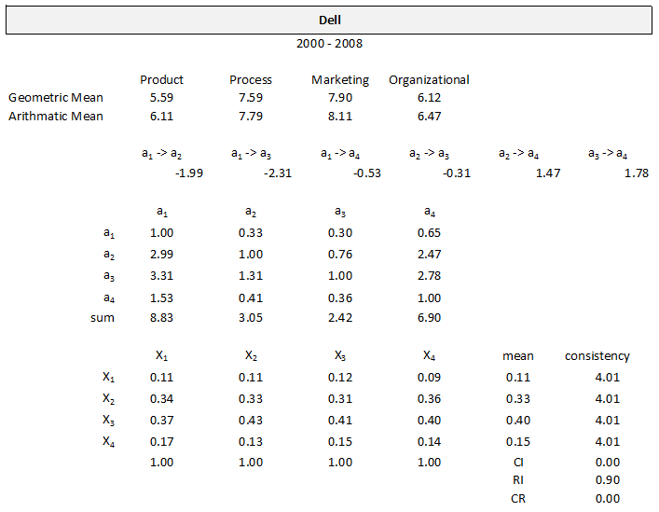
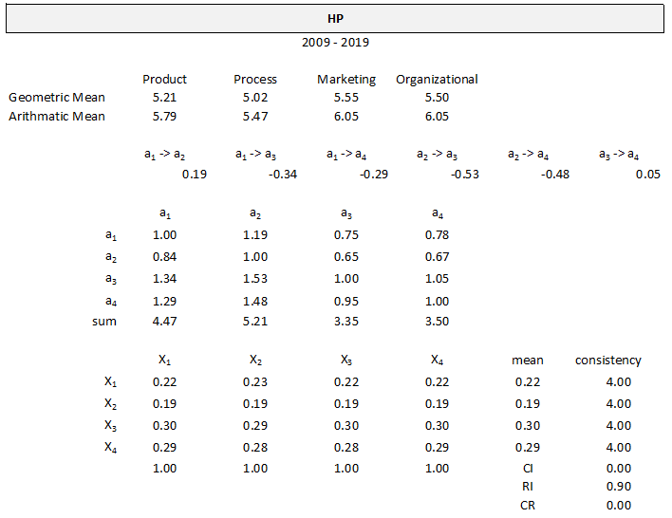
AHP Results

Slide 41
AHP Results

Slide 42
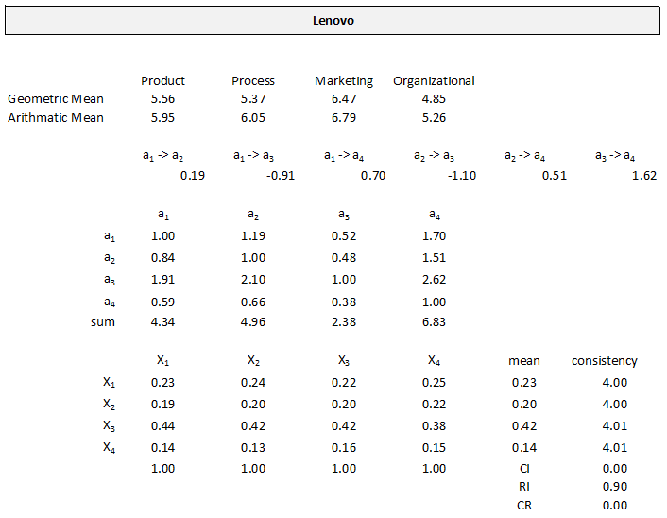
AHP Results

Slide 43
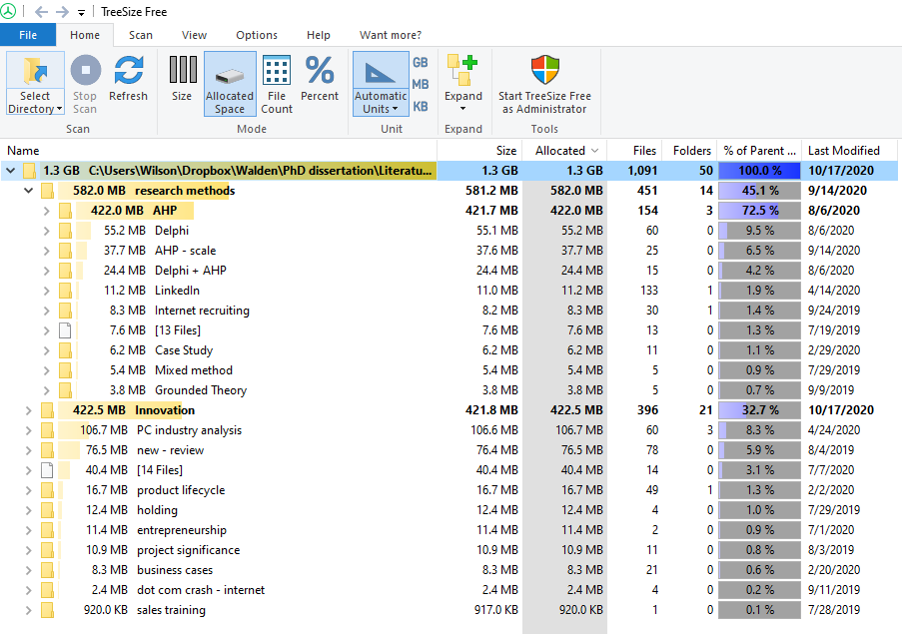
Research Sources
Digital Resources
+ traditional print publications…

Slide 44
Diffusion Curves

Slide 45
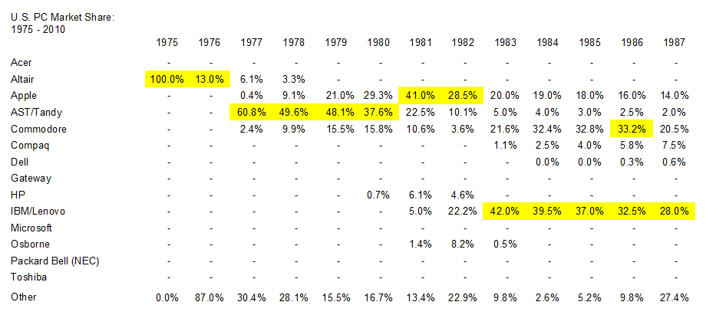
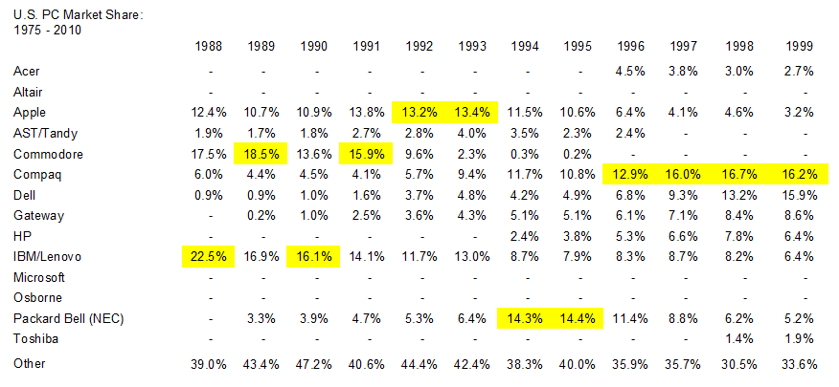
PC Market Share Data
U.S. PC Market Share
1975 - 2019
U.S. PC Market Share
1975 - 2019

Slide 46
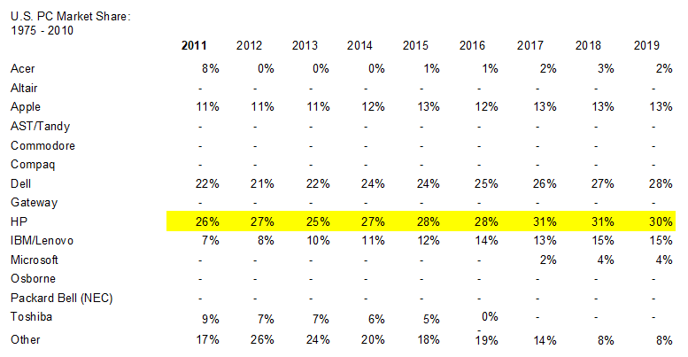
PC Market Share Data
U.S. PC Market Share
1975 - 2019
U.S. PC Market Share
1975 - 2019

Slide 47
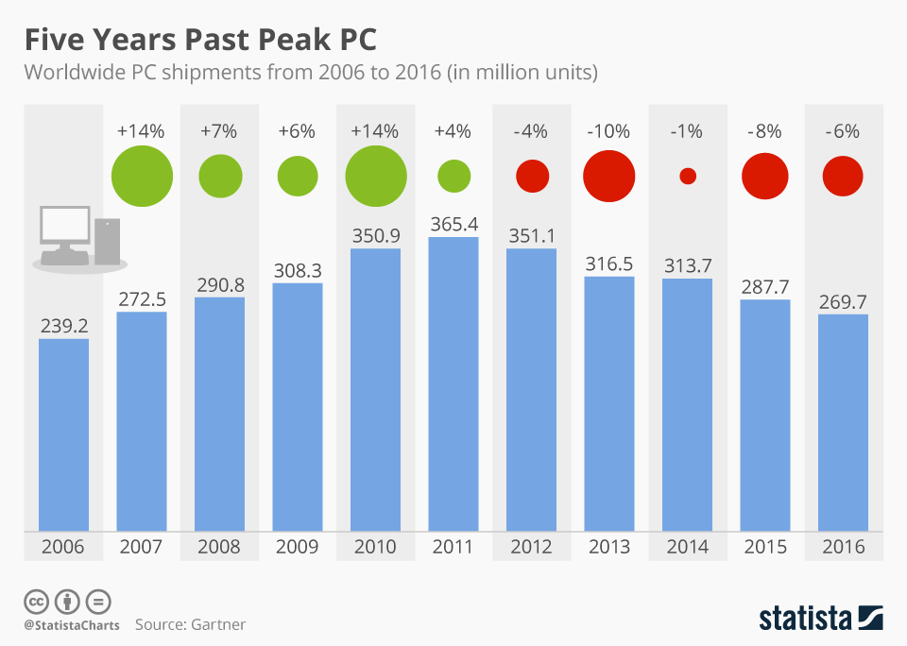
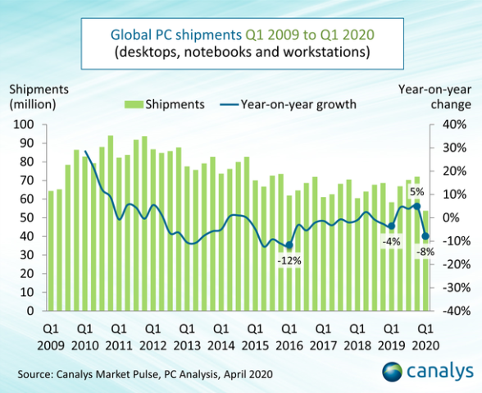
Recent Sales Results (Global)
Richter (2017)
Kannan (2020)

