Slide 1
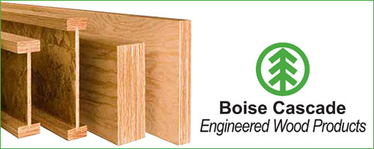
Stacy Duman, Trisha Wardlow, Vanessa Sahlfeld
Notes:
Hello, we are Stacy Duman, Trisha Wardlow, and Vanessa Sahlfeld, and we are currently business students at Eastern Oregon University, This project is a part of our BA 498, Business Policy & Strategy capstone course, and as a group we did research to help Boise Cascade to discover their visibility in the community.

Slide 2
Objective
Survey
Current Activities
Research possibilities
Notes:
We were asked to find new ways for Boise Cascade to improve community engagement and create additional visibility with the local public. To find these new ways we conducted two surveys. The survey's presented us with the results we needed to research the possibilities on why the community might be unaware of Boise Cascade's contributions. Looking at your current activities we were able to answer the questions asked, as well as bring together new tactics that might help increase visibility and in turn recruit the best talent.

Slide 3
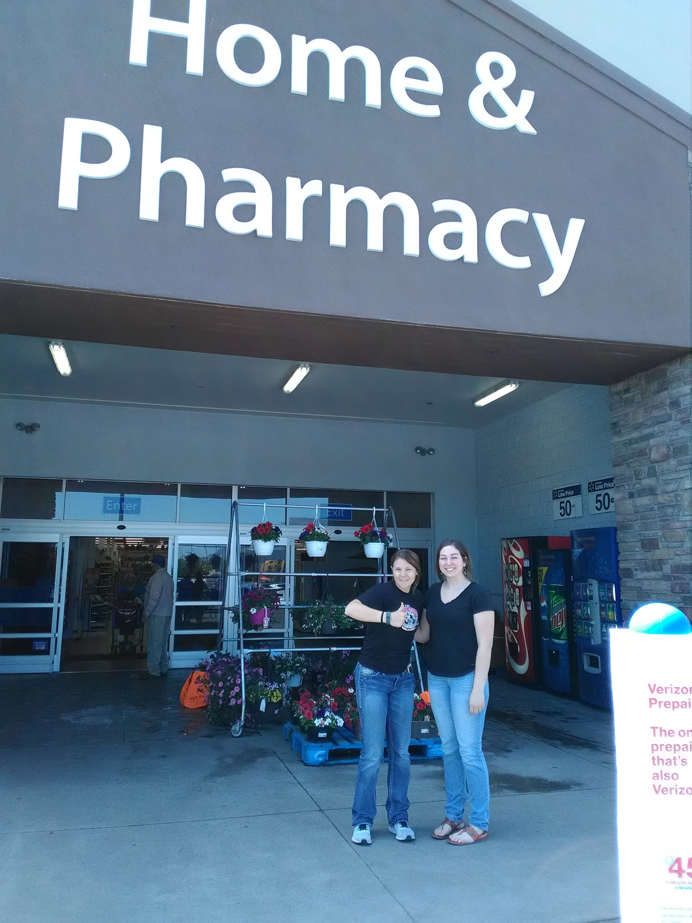
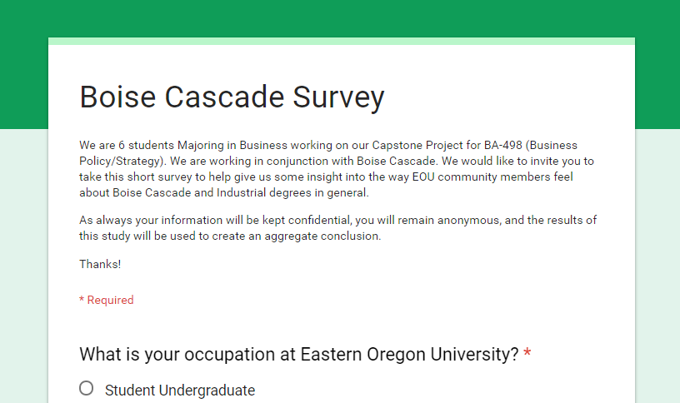
Survey
Notes:
We conducted two surveys, one was through EOU, and the other we went to the community members. The first survey we collaborated with our fellow class mates and created a survey that would benefit us both. This survey was sent out three different times through student affairs to EOU students and staff. The second survey we conduct was more specific to our project. We wanted to get the communities overall perspective of Boise Cascade. We spent two different days collecting data outside of Wal-Mart. The questions we asked the community were similar to the questions that were asked to EOU students. Analyzing the data we were able to decipher Boise Cascade's different strengths and weaknesses. This information helped us to develop new ways to approach the question of your visibility.

Slide 4
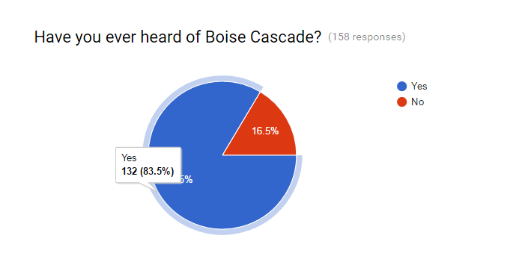
Notes:
This is one of the first questions we asked on the EOU survey asking: have you ever heard of Boise Cascade? And out of 158 responses, 132 responded yes. An outlier we must consider is from people that are not from Union County or even Eastern Oregon.

Slide 5
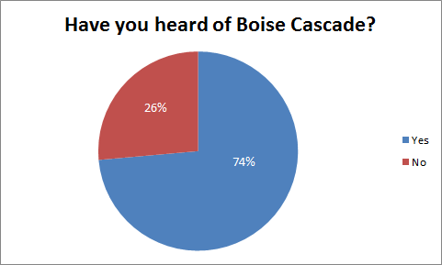
Community visibility
39
14
Notes:
We asked the same question to the Community. Out of 53 participant, 39 of them knew who Boise Cascade was. An outlier we must consider is from people that are not from Union County or even Eastern Oregon.

Slide 6
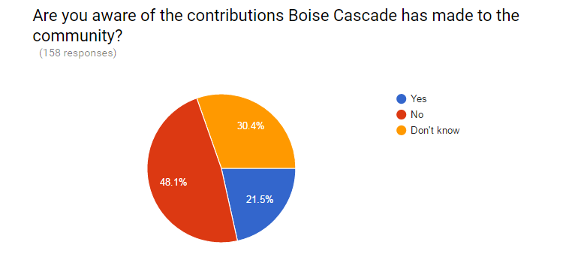
Contributions
Notes:
When we conducted the EOU survey we asked the question if they knew about the contributions that Boise Cascade make in the community. The results as presented shows that 78.5% of the people don’t know about what Boise Cascade is doing to contribute. This just shows us that the contributions are not being seen in the students and faculty at the college.

Slide 7
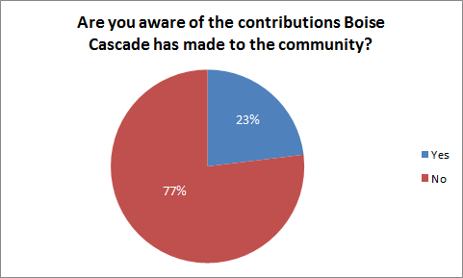
The communities idea of their contributions
9
30
Notes:
We also asked the 39 community members at Walmart (Island Avenue, La Grande OR) that knew about Boise Cascade in the first question, if they knew about the contributions that Boise Cascade makes to the community. Only 23% of the 39 knew of any of the contributions around the community. This shows that the community members also don’t know about the contributions that you are making to the community.

Slide 8
Three different categories
Advertising
Sponsoring
Community
Notes:
Our group took your current activities and grouped them into three categories. These three categories were specific area’s that Boise Cascade had different weaknesses. We took those weaknesses and created recommendations that could help bring back visibility with your community.

Slide 9
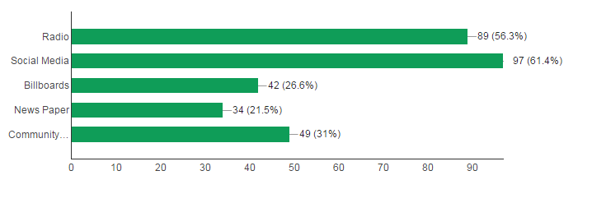
Results for Advertising
Notes:
After surveying 158 EOU students from online, onsite, and sister-campuses. The results that were the most popular with students were social media and radio advertising. These results make the most sense with the age group the college is based around. Community events came in third because La Grande has several events throughout the year it is important to get your company’s name out. Boise Cascade does a lot of sponsoring for community events. By advertising through sponsorships this helps the community recognize what Boise Cascade does for Union County. Boise Cascade is also the largest employer for Union County.

Slide 10
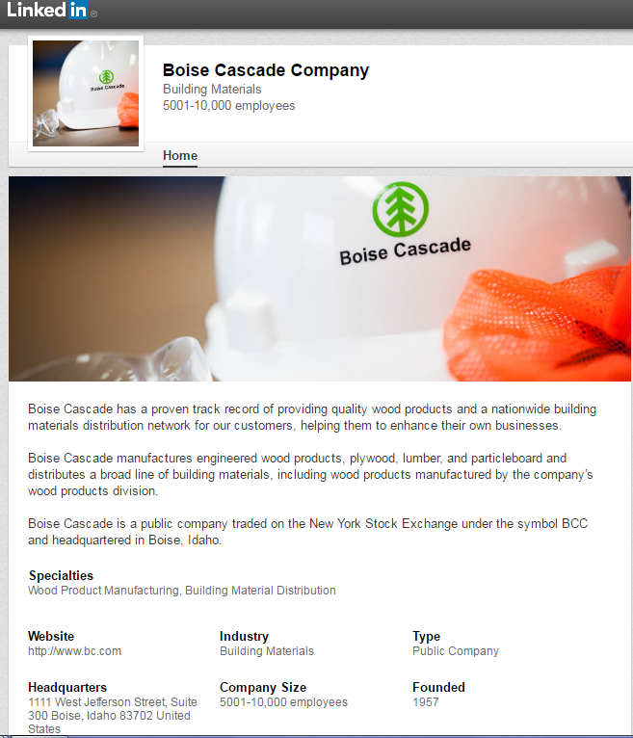
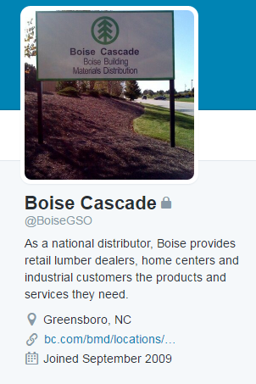
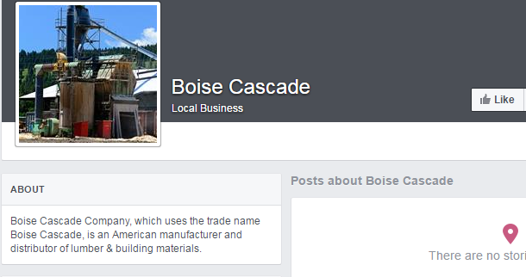
Social Media
Notes:
After scanning the internet for social media accounts Boise Cascade is linked to the main sites were LinkedIn, Twitter, and FaceBook. LinkedIn is a professional social media account that connects you to job opportunities, successful people, and creates an important environment for young professionals. The Boise Cascade LinkedIn account had a lot of helpful information on it. The most impressive posting I came across was the job listings. Boise Cascade has done an incredible job on listing all job opportunities on this site. It was a smart site to post jobs on, although it is a little difficult to find jobs in your area without opening individual links.
Twitter is a great tool if you are wanted to advertise concise messages or posting a link to job opportunities. It can also help your imagine presented to a younger crowd such as college-aged students. The site I found was from North Carolina. This twitter didn’t have anything mentioned of the feed. Here in Union County a lot of 20-30 year olds use twitter for news and media source.
FaceBook is always a great form of social media and has become preference in other generations.The page we found did not have anything posted on it. When you search Boise Cascade there are many articles that have been posted about the company on news channels, newspapers, and government officials that have toured the plant. Being able to link the articles onto a FaceBook page is beneficial for users that use FaceBook for another means of gathering information. By creating a link to job listings this can make another portal of opportunities. People on FaceBook have talked about Boise Cascade and that is free advertising. A way to link the two would be an important part to receive infomation.
https://www.facebook.com/pages/Boise-Cascade/107704875923694
https://twitter.com/search?q=boise%20cascade&src=typd
https://www.linkedin.com/company/162755?trk=vsrp_companies_res_name&trkInfo=VSRPsearchId%3A4168306531464372339367%2CVSRPtargetId%3A162755%2CVSRPcmpt%3Aprimary

Slide 11
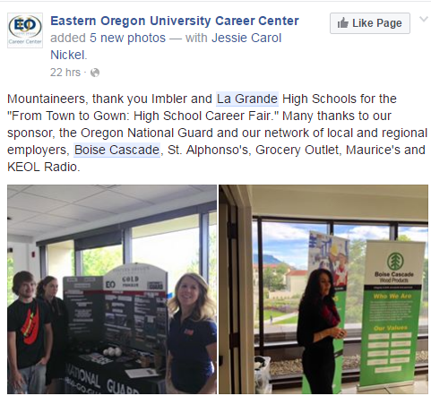
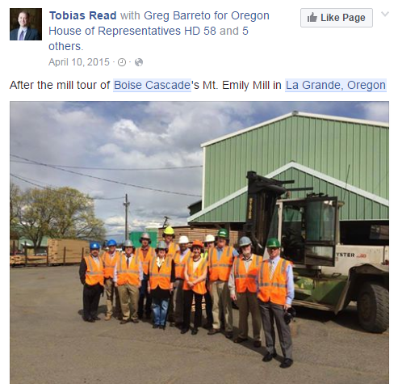
Notes:
Here on FaceBook are two examples of how creating a link between what people are mentioning about the company and to a Boise Cascade page would be important to see what work Boise Cascade is doing in the community. Since Boise Cascade is doing a lot of sponsorships, FaceBook is free advertising to show the community what you are doing for them. The great thing about social media is it can be seen throughout the world. Boise Cascade has a hashtag associated with their name. Once you search the hashtag a lot of articles appear that include the company’s name.
https://www.facebook.com/EOUCareerCenter/

Slide 12
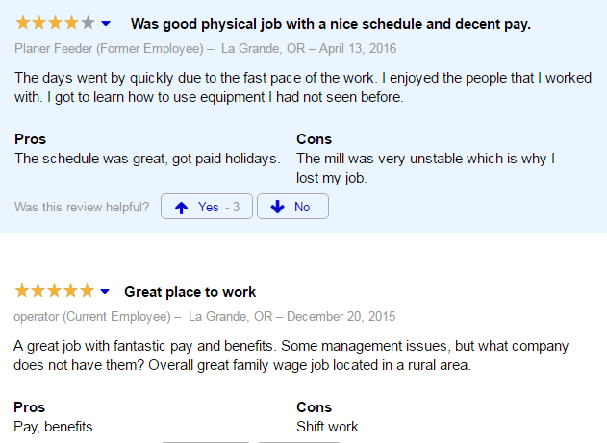
Notes:
These two reviews about the company came from Indeed.com.The two comments complimented pay, location, and learning aspect. We understand that these are outliers to our project, but the positive comments match a question we asked our community participants: does Boise Cascade have a positive or negative image in the community? Out of the 39 community members who knew who you were, all 39 said they had a positive view of the company.
http://www.indeed.com/cmp/Boise-Cascade/reviews?fcountry=US&floc=La+Grande%2C+OR

Slide 13
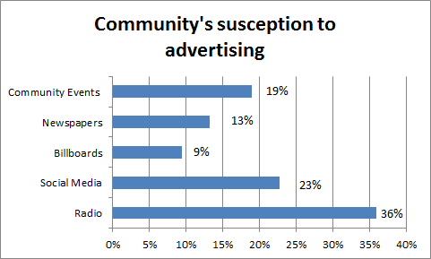
Community was more susceptible to...
Notes:
We asked the community members the same question as our EOU survey which was what they were more susceptible to. The first two options were opposite from what EOU said. Community members said radio was the first advertising they would be likely to hear. Next, social media, such as Facebook. Facebook is great alternative to get your information for the community from.

Slide 14
Radio
Looking for a job with great pay and benefits? Good news! Boise cascade is looking for entry level, general, laborers who want a competitive wage, benefits and a chance for advancement. No experience or advanced education required! Apply now at Work Source Oregon or on-line at BC.com. Applicants must be 18, have a high school diploma or equivalent, or two years of manufacturing experience and be legal to work in the United States. Boise cascade is an equal opportunity employer. Women, minorities, veterans, and people with disabilities are strongly encouraged to apply.
Notes:
This is the radio ad Boise Cascade played during the summer of 2015 to gain employees. The ad was strictly to obtain employees. We thought a great idea would be to have a running ad about what you do for the community. Especially since you are the largest employer in Union country and since a lot of people in the community thought the company was shutting down the Mt. Emily Mill. This would be a friendly reminder for the community to remember you are still here and still doing well. A radio jingle such as Commercial Tire or Les Schwab would keep a positive review in the community. Also, the two surveys we conducted had radio advertising either in the number one spot or the second. This is advertising that would reach Union, Baker, Wallowa, and Umatilla County.A majority of Eastern Oregon is able to tune into 99.9 and 103.3 and hear the radio advertising play. This is another option to give your company.

Slide 15
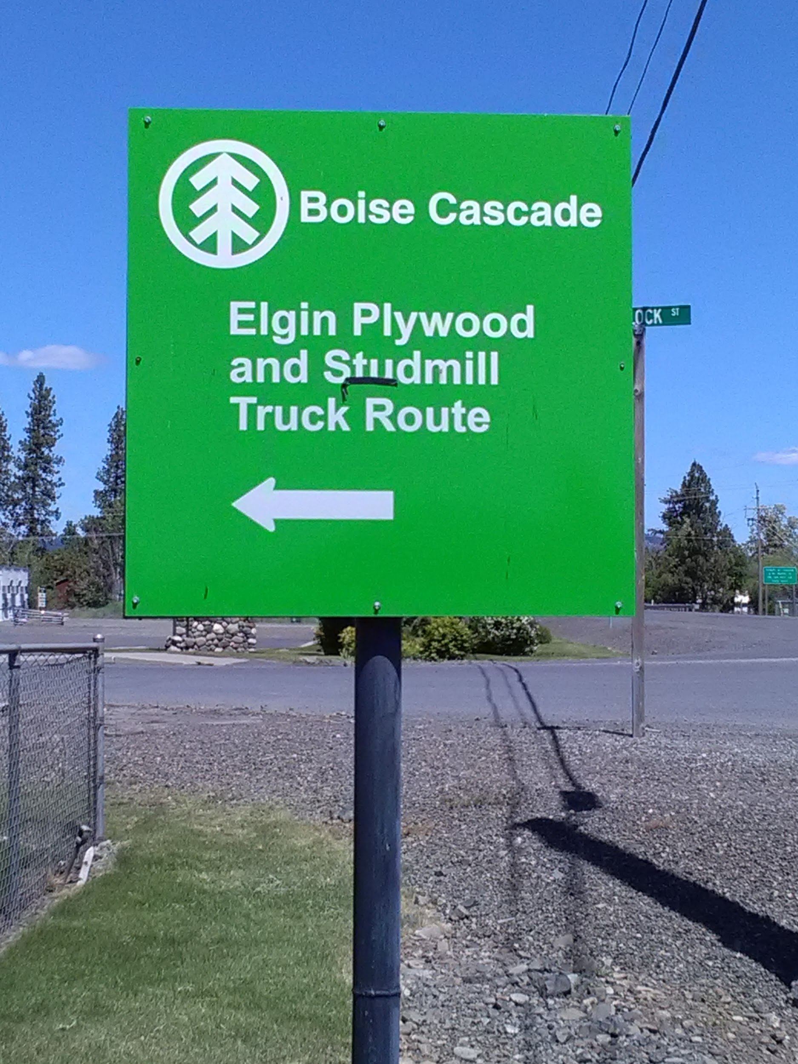
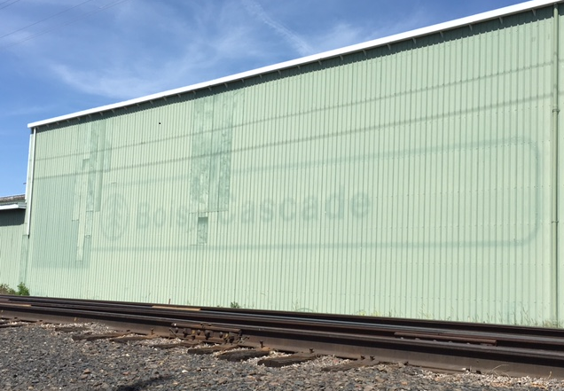
Signs
Elgin Baseball Field
(Beside the highway)
Notes:
Advertising and sponsoring go hand in hand. One thing that Boise Cascade did well was in Elgin, OR at the Elgin Stud Mill. The sign on the right is located in Elgin when you’re entering the city. It is a bright green sign and displays the Boise Cascade name, but it is also a truck route for the company. It is great advertising in the town of Elgin, but it is also on a highway going toward Wallowa County. The sign on the left is not a good thing. There were rumors that either Boise Cascade was shutting down the Mt. Emily Mill in La Grande, OR or they were closing that part of the building. This faded sign that is locaton on Island Ave gives off the notion that Boise Cascade is closed. In fact, Boise Cascade is not. A way to help tell the community that Boise Cascade did not close down would be to put up another sign somewhere on Island Ave. Since La Grande has Eastern Oregon University is also helps let everyone know what you are. This is another idea that Boise Cascade could do to adopt a newer look.

Slide 16
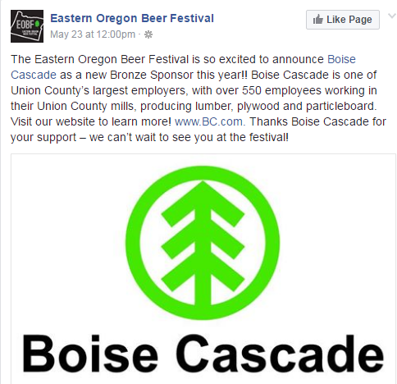
Sponsoring
You already sponsor:
Community events
Little league teams
And so many more
Notes:
We are aware that Boise Cascade is already has many sponsorships, but there are many other opportunities to do more in the community. These range from donating money to the booster clubs, sponsoring little league, as well as events like the beer festival here in La Grande. These are all great ways to get your name out there but I’m going to take this time to deliver other ways that sponsorships can help you get the right image out to the community.
Sponsoring has many benefits. The biggest one as mentioned before is to get your name out there. Sponsoring is a great way to do this because you can pick what you sponsor to better target the market that you are aiming for. Another reason that sponsoring is ideal for all companies is the media exposure that you get from sponsoring events. People will post about it and they have the opportunity to post to the Boise Cascade page if it was managed the proper way. People have already been doing so with the page you have now as pointed out earlier in this presentation.
We understand that people are busy with their own full time jobs and personal lives so they are not willing to take the time out of their day to volunteer for this position. It may be beneficial to create a position that fits this need and to be able to manage all of the social media to make the perception in the community that you are hoping for. This is a good way to attract perspective employees and to put awareness in the community that you are actively accepting applications for open positions like the one that the other group will be talking about later.

Slide 17
Sponsoring continued
Fun runs
La Grande open streets
Notes:
We have the list of places that Boise Cascade makes donations, but one thing that we have previously talked about and that is not on the list is fun runs. This could be a simple and inexpensive way to get your name out there. You don’t necessarily have to fund and plan the whole run, you can simply get a group together and partake in a fun run that is already being held. All this would take is employee volunteers and t-shirts for the group to help the, stand out and to represent the company.
La Grande Open Streets was an event last month that opened Adams up for vendors and other outdoor activities. This was to get people out of the house and doing activities outdoors. A part of this event was a fun run that was put on at Pioneer Park. This is just one of many events that Boise Cascade could be a part of.

Slide 18
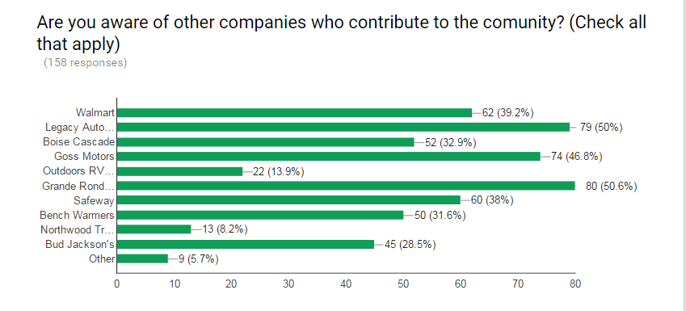
Taking ownership in the brand
Notes:
Out of the 158 students that responded to our survey, only 52 of them knew of contributions that Boise Cascade makes to the community. We know this is not because of not having contributions, but due to the fact that you are not recognized for your contributions. After looking extensively at the company we believe it is due to the way that you are making the contributions. When you donate money through booster clubs, and other groups like these, the money is not allocated to certain things. Instead the booster club decides what they money is best used for and you don’t get the recognition for it. So instead of donating to booster clubs, it may be more beneficial for Boise Cascade to donate to specific events or teams - that way the recognition is correctly representing your company.

Slide 19
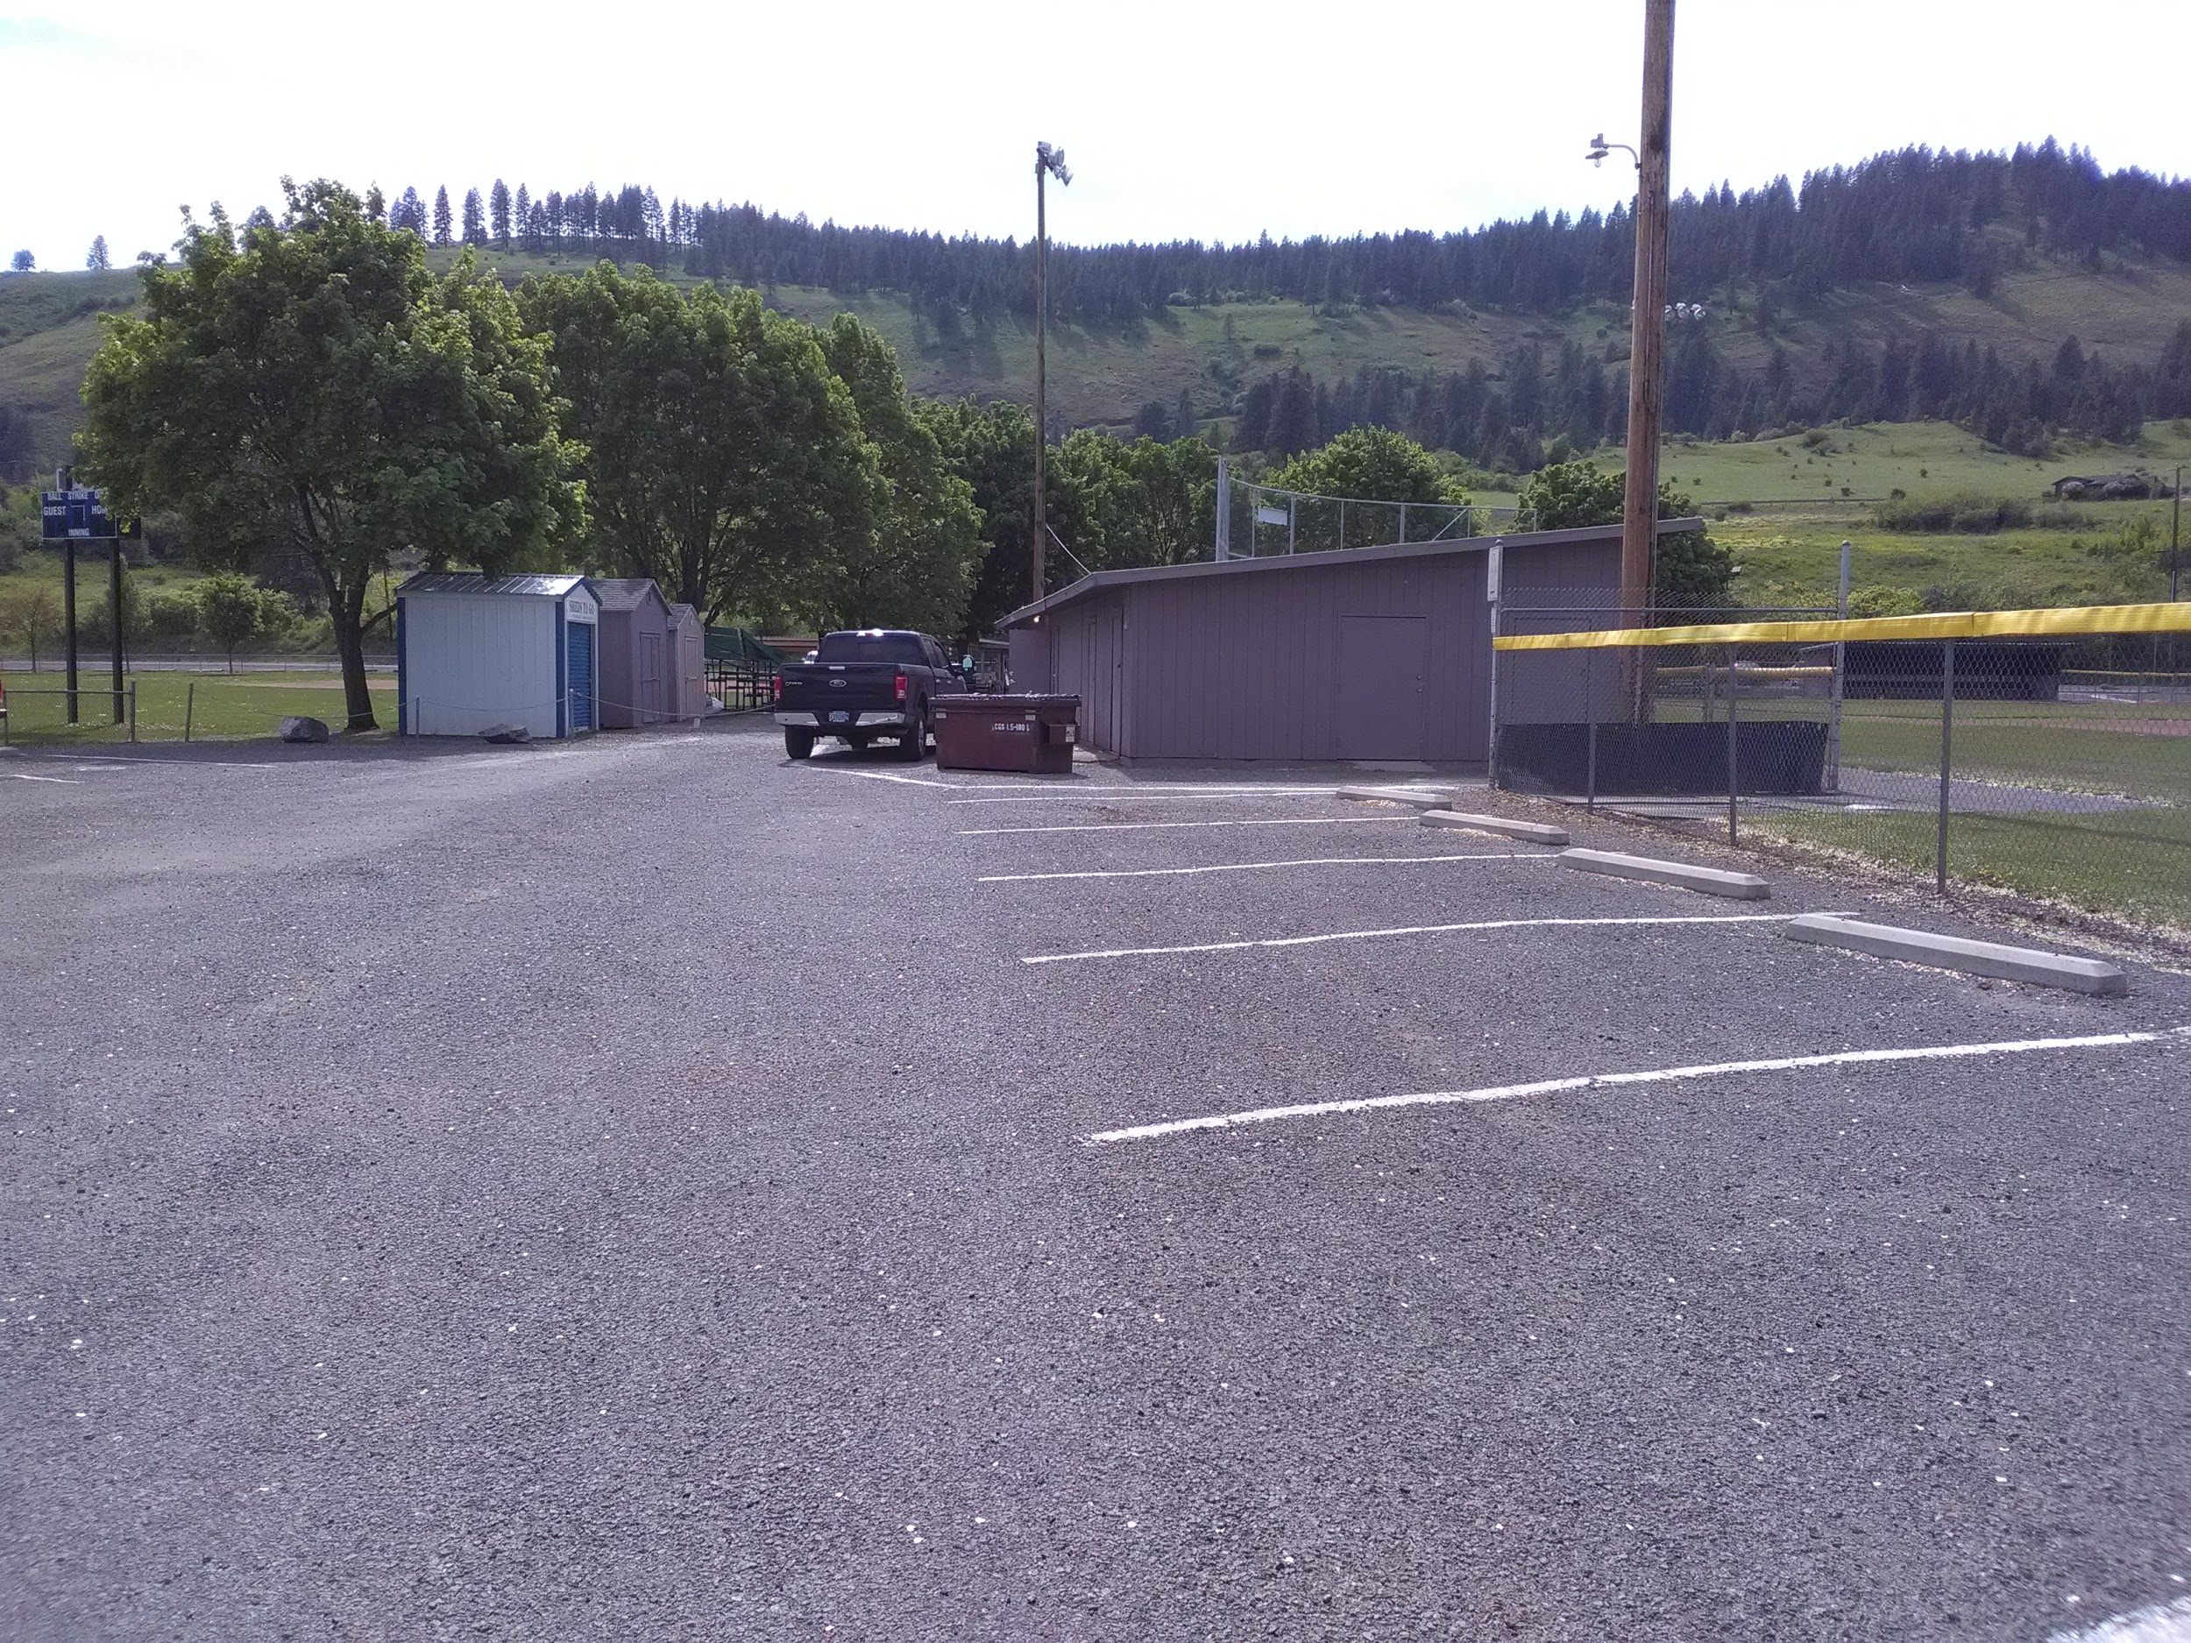
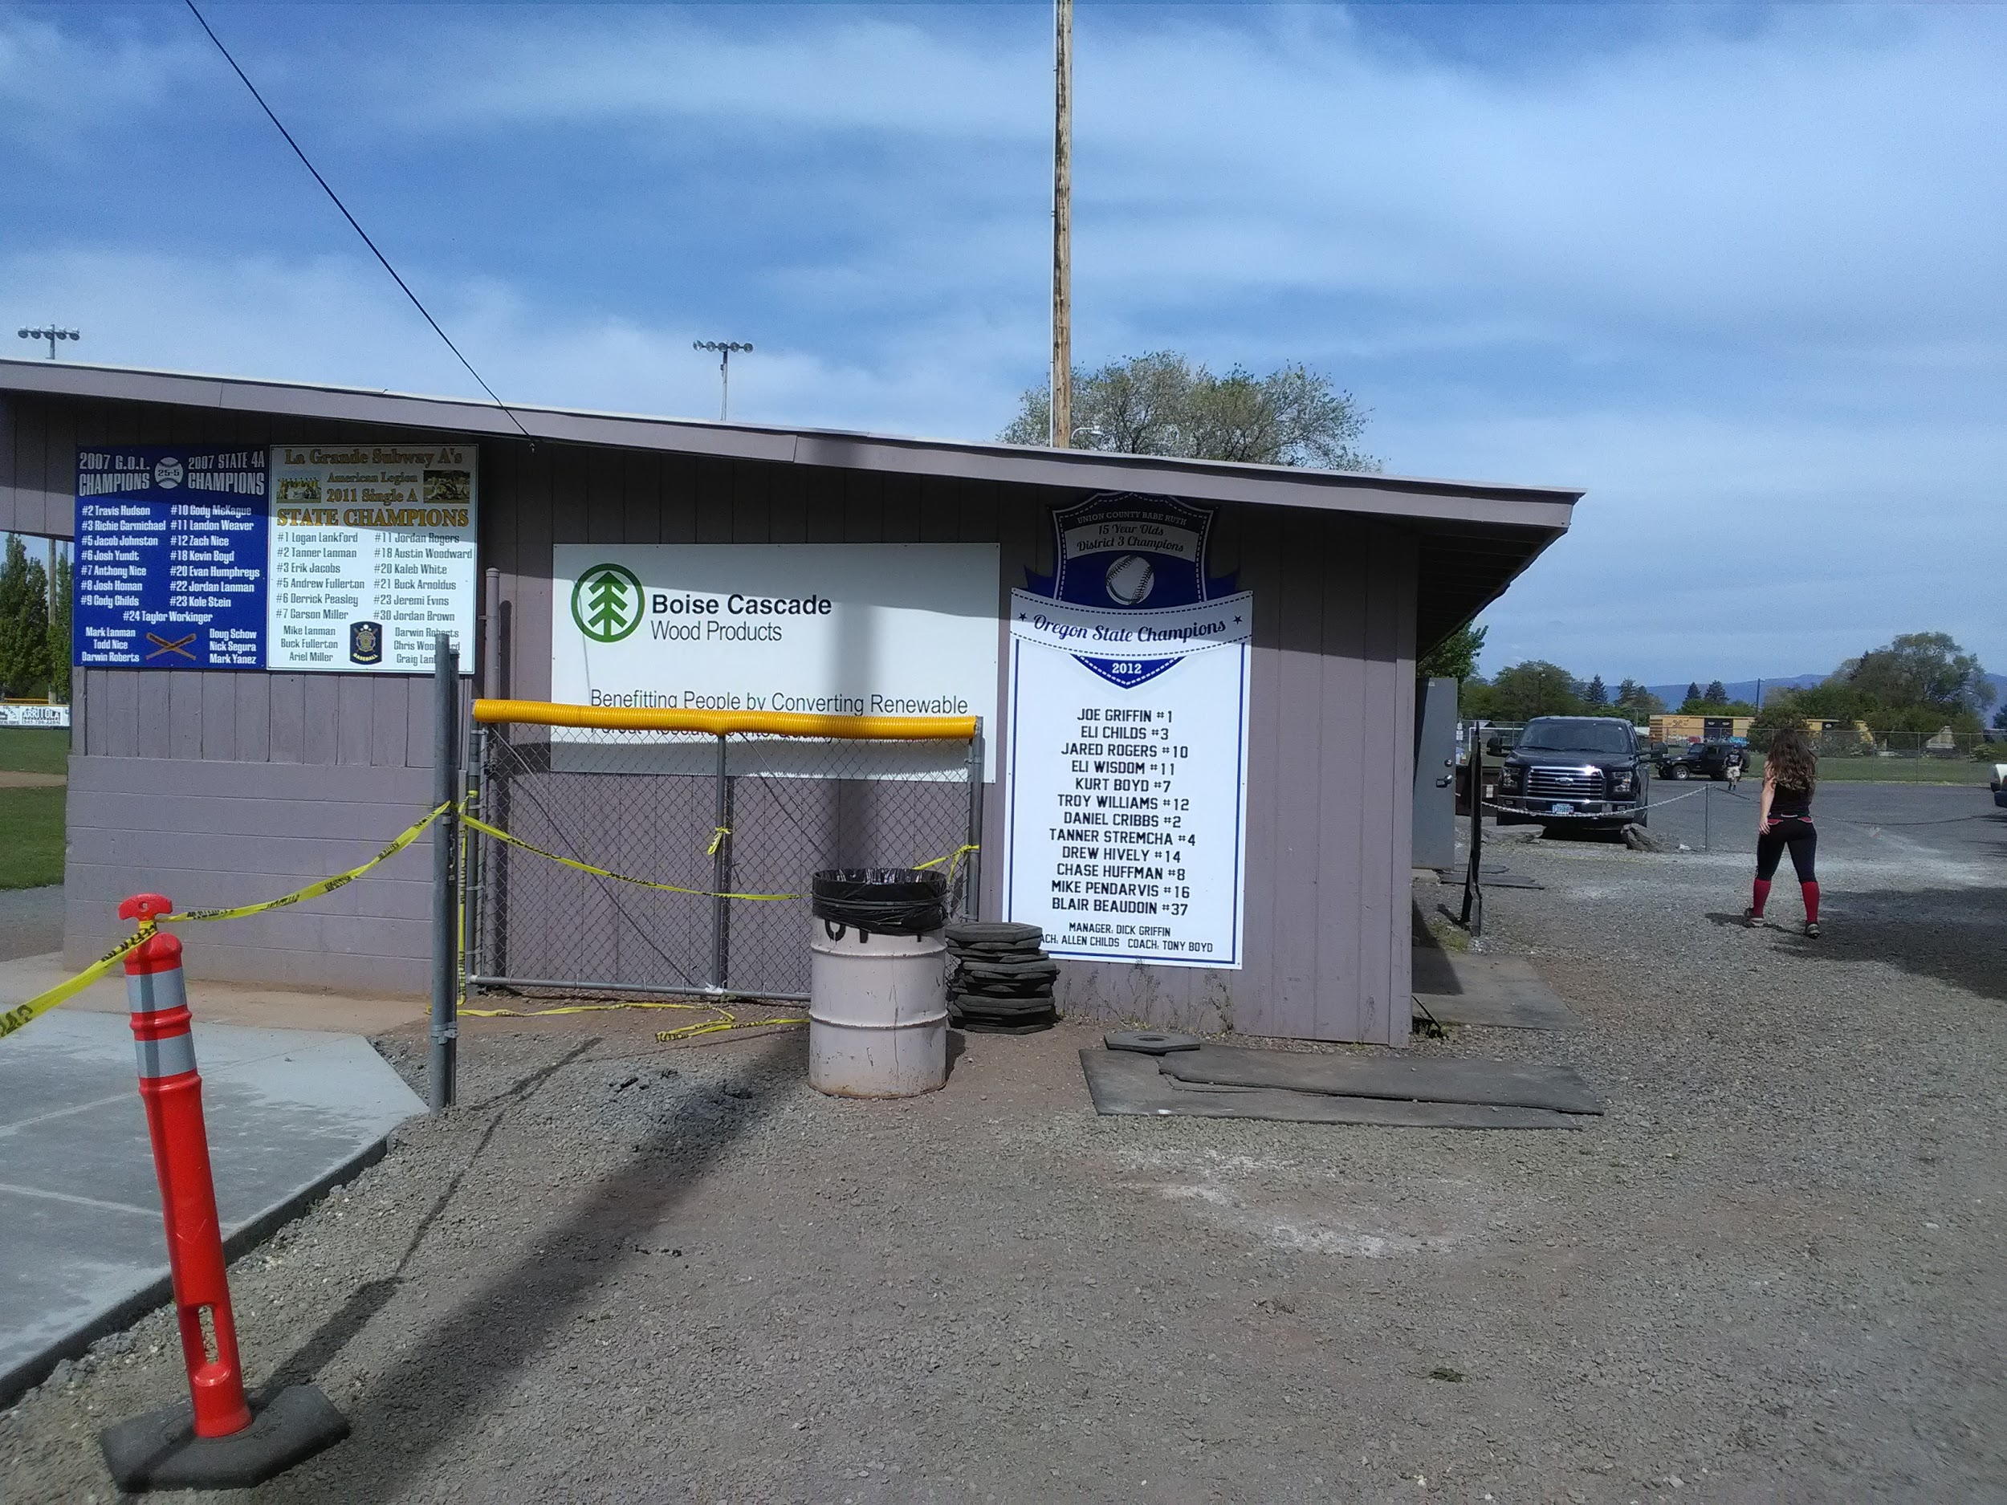
Pioneer Park sign
From the parking lot From the other side of the dugout
Notes:
This is just a demonstration of the signage that is available on sponsored fields. As you can see in the first picture that is taken from the parking lot of Pioneer park. You are not able see the Boise Cascade sign until you walk all the way around the dugout. Even when you can see the sign the sign is blocked by the gate and it is mostly white space that could potentially be filled with the logo and other information to better attract the eye of people passing by.

Slide 20
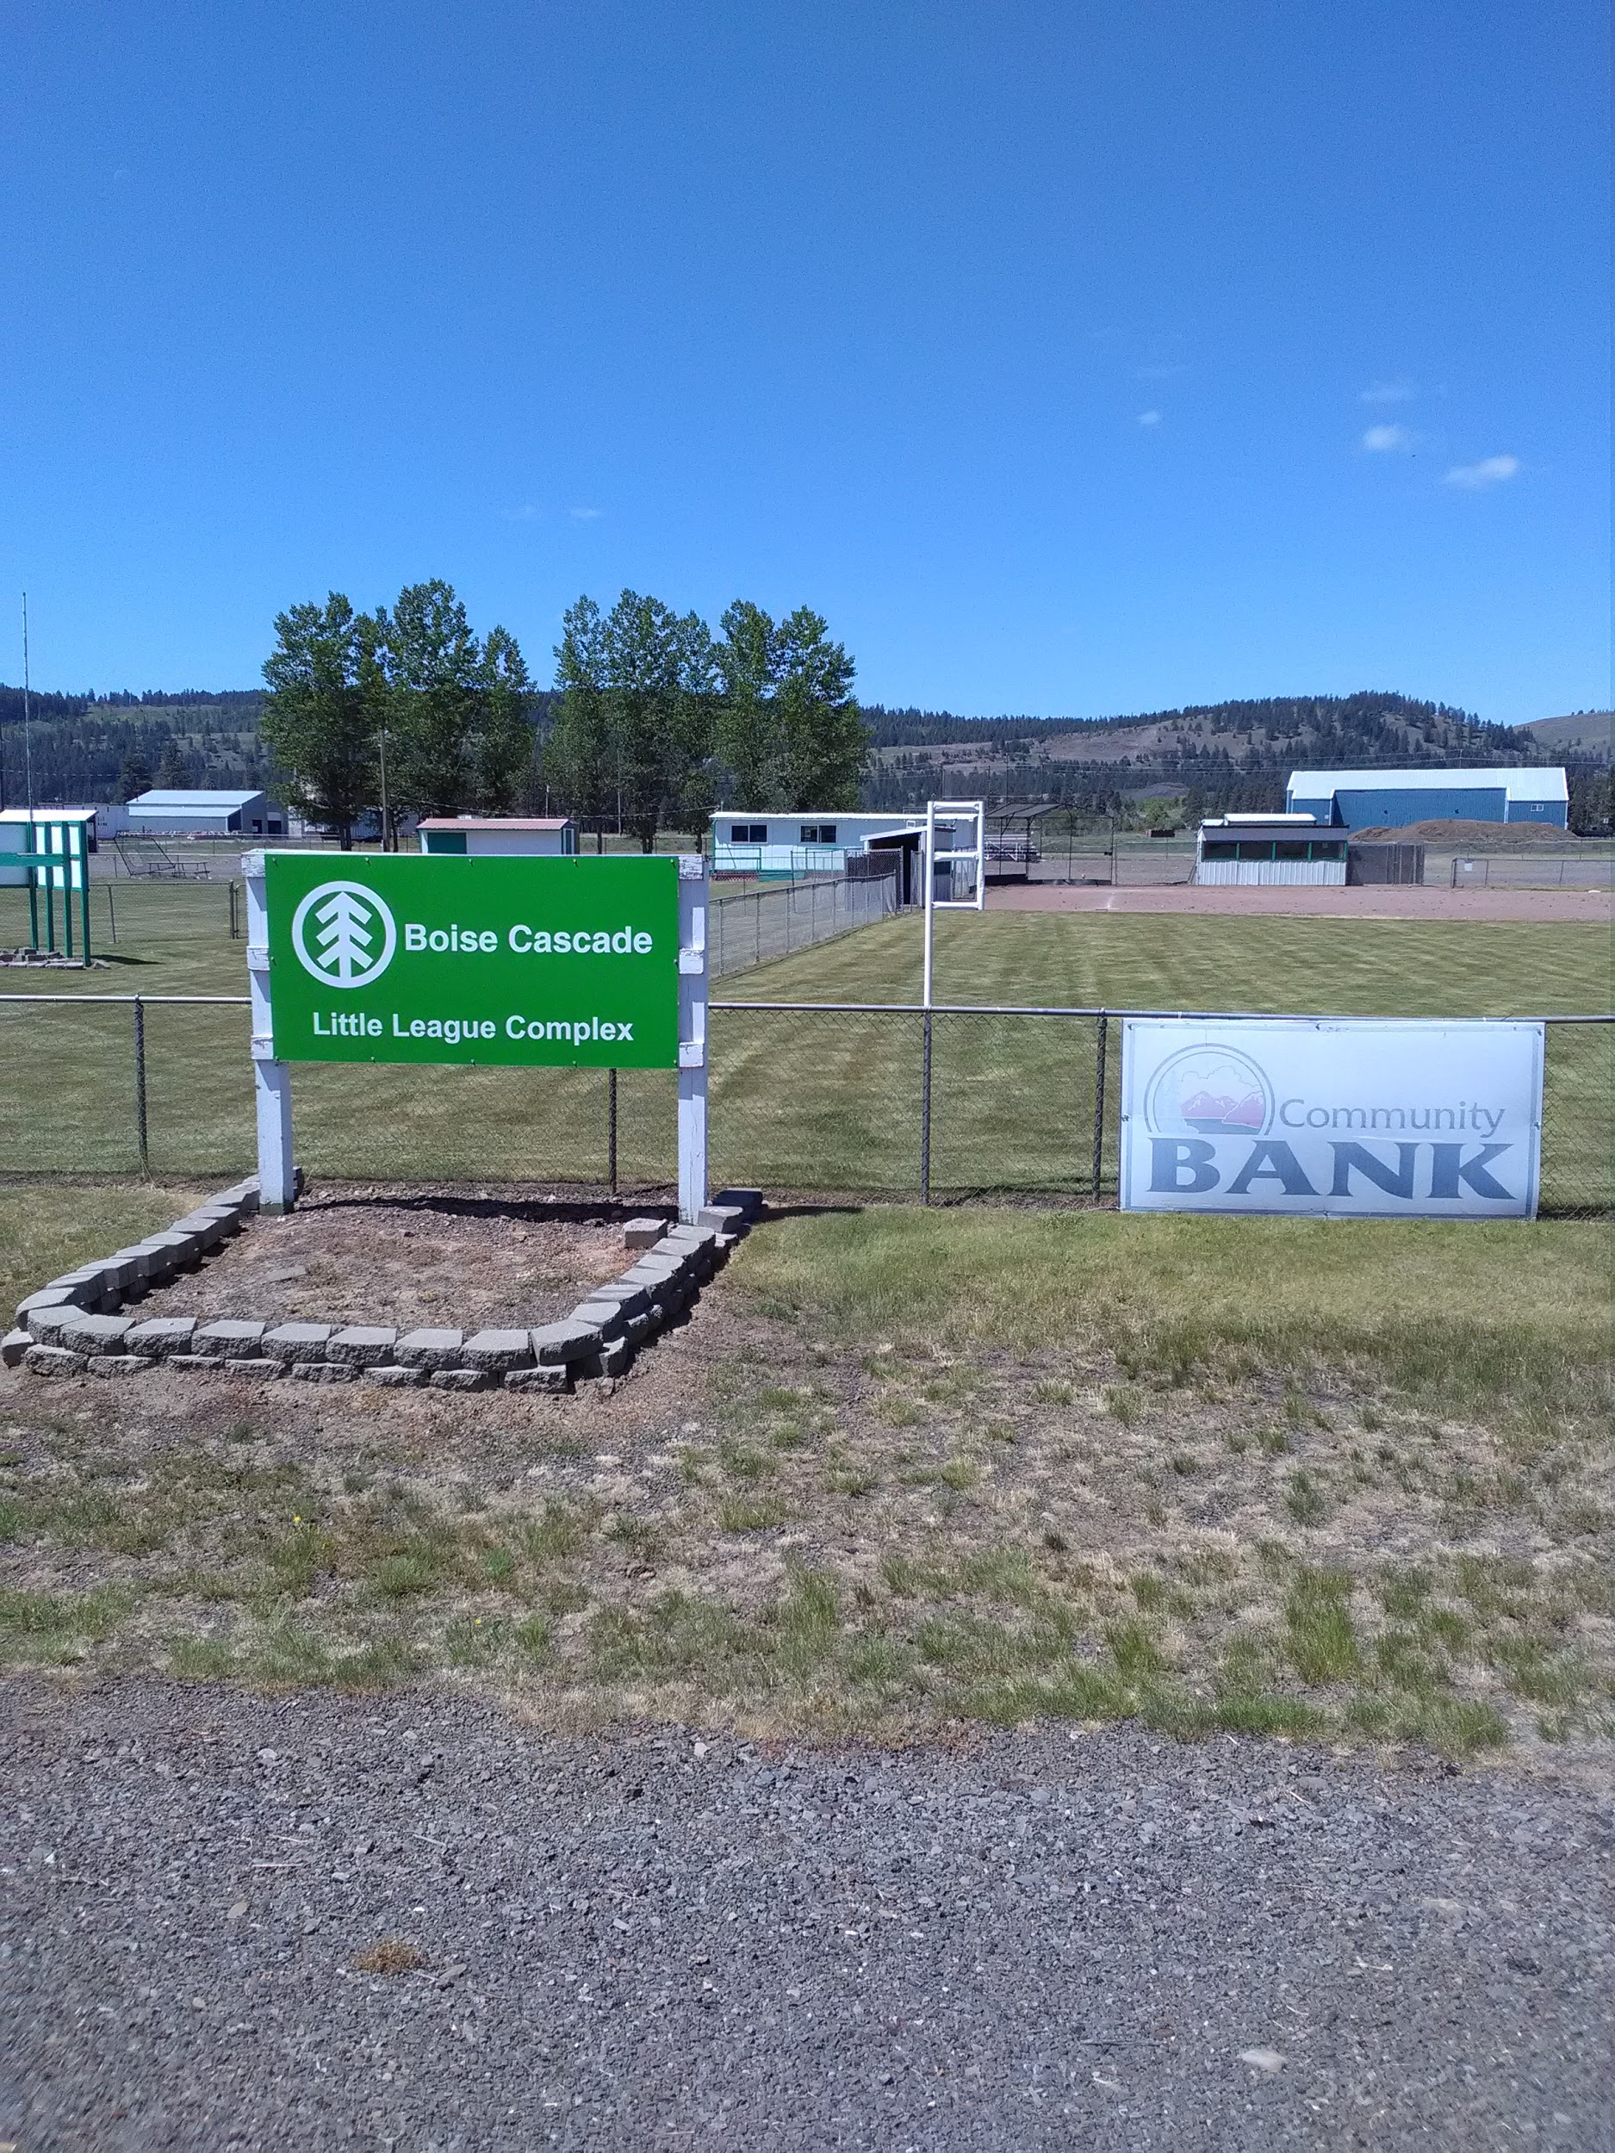
Elgin ball park
Prominent sign right out front
Can be seen from the highway
Clear and obvious
Notes:
This is the sign that is out front of the Elgin ball park. It is a very colorful sign that is prominent and it is easy to see from the highway. This sign is a better use of the space and it is will help with drawing people into the park. Most importantly it is very evident that Boise Cascade sponsors this field.

Slide 21
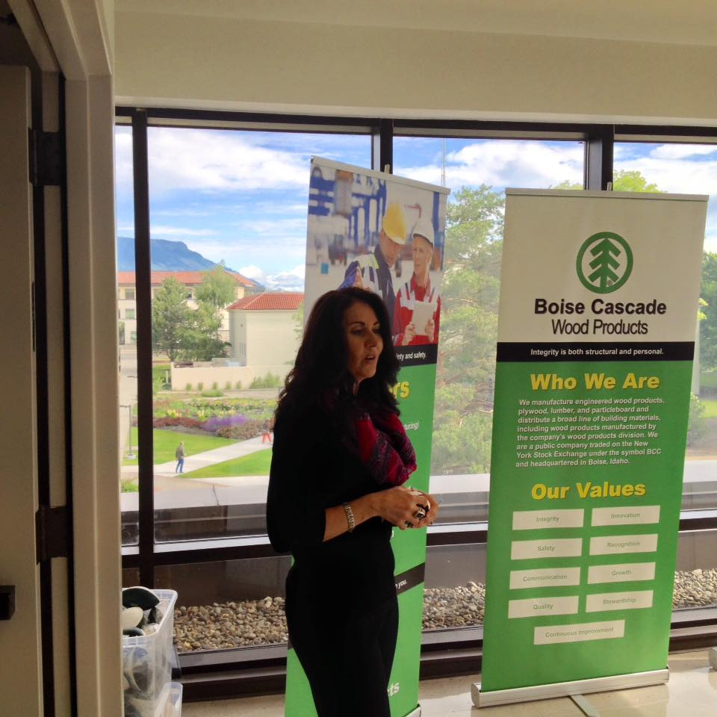
Current activities
Notes:
This photo is currently the only photo we could find online of Boise Cascade’s involvement in the community. It was recently taken during a Career Fair put on for local High Schools. As you’ve already seen from the data you are visible in the community and the visibility is positive, but the community members are blind to the contributions that you make. While we were gathering data at Wal-Mart, we talked to a local who has lived in La Grande all his life, and he could remember seeing booths from Boise Cascade set up at every local event. He also recalled times when you would have fun activities and prizes like coolers with your logo.
This conversation stood out because our results were able to back up our thoughts about the fact that you are visible as an organization among the community. However, that awareness is dated - you had such a strong image in the past, but the current image is lost. We believe that the loss of visibility could be from when the [Mt. Emily] mill shut down. Boise Cascade is such a huge employer and to shut down a mill in a small community like La Grande is devastating. Once the doors re-opened a gap of uncertainty had already been created between Boise and the community.
You make great contributions to the community, but it is all hidden from La Grande's eyes. Someone needs to take charge of your image and create more visibility. That way when someone's searching for a job they can see the positive contributions Boise Cascade makes for their community. Instead of leaving your community to dig for pictures like the one shown here.

Slide 22
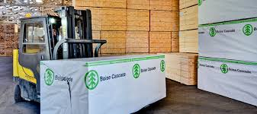
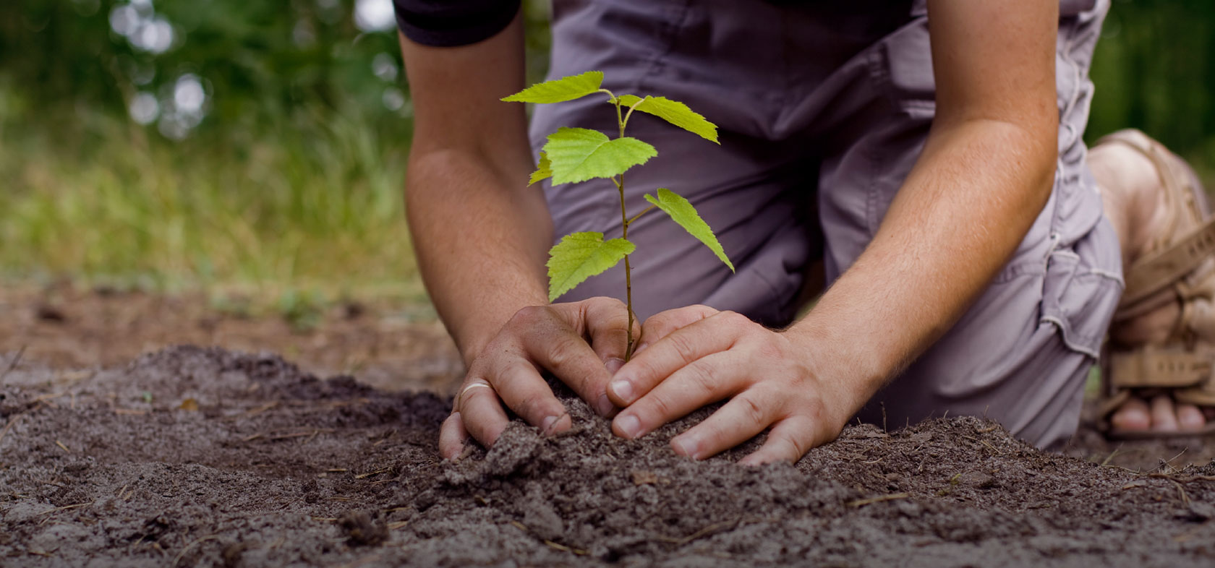
Notes:
Here are a few ways we researched and felt would help inspire future talent to choose Boise Cascade for a career and get the community excited about the business.
One idea is to use a tour package to use to show off the different mills and how they operate even when they are down. Creating a virtual tour can also be a great way to open people's eyes to exactly what you do. As BLOT [Business Leader of Tomorrow] Club members, we visit and tour different organizations and it’s a great opportunity for us to see the potential possibilities that are out there. It also gives us a better understanding of the different aspects of the business world. Manufacturing isn’t a extremely appealing job for many students. But offering these opportunities for groups like Boy Scouts, Schools, and Clubs, you are able to shine a light for people who might be interested in a career like (insert job title)? Currently you have a 5th grade class come and tour the Mt Emily plant, which is great. But expanding your tours can also be a great way to start educating different groups about the future advancements open to them.
In addition, you could become more connected with La Grande and all of its activities. There are many parades and community activities where you could set up booths or create floats to show your involvement in the community.
You could also create different games, such as an example from my hometown [Vale, OR], called the logger games. Olsen Lumber, the local lumber store, donates lumber during the Fourth of July rodeo and puts on a competition where businesses in the community make teams and compete against each other in different events. It is a huge success within the community.
Another way to help could be by instilling more company pride into your employees by having more events internally like the logger games. It also helps to create a strong bond between your employees. Keeping it friendly but also creating a more connected environment within the company. With such a big organization it can be difficult to create a culture that ties into each mill location. The activities can also be themed based on some of your core beliefs like safety. By bringing them all together, and promoting your core values, your employees outlook on their company could reflect back into the community. Then maybe the community will have a better understanding of who you are and what contributions you make for the community.
With our research we’ve already proven you guys are visible, there is just some kind of spark that is missing between you and the La Grande community members. So another way that might be beneficial to boost your reputation could be to do some type of donation that connects to what you do, such as maybe creating some kind of program where community members participate in some way, and then Boise Cascade donates a tree back to the community, or maybe some other kind of charity that connects to your internal views/values.
If you do any of these activities, you also have to take pride in the contributions and plaster them EVERYWHERE. If you create a logger games within the company or community, post pictures on your website to show the community you are a great company. Also, become more connected with the local events that make La Grande unique, like parades, and make sure to set-up booths at every activity. Then connect with the radio stations and scream to the world that your donating to charity or going to be participating in community events.

Slide 23
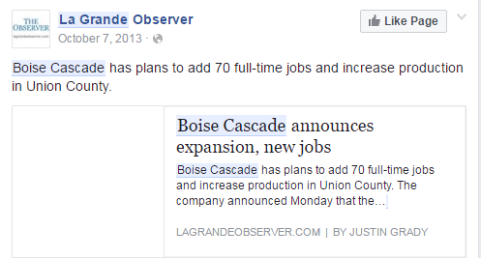
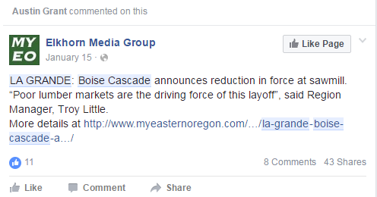
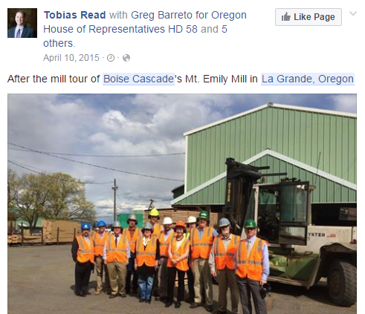
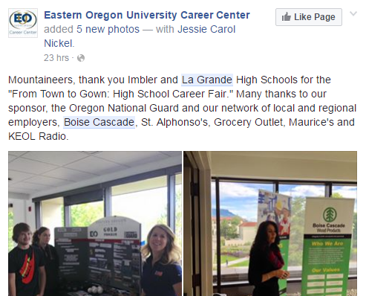
Notes:
The main take away from our research would be for Boise Cascade to take ownership for the contributions they make.
You distribute money to the community but much of it is not visible. Taking ownership will help Boise Cascade capture the recognition it deserves.
We also recommend creating a position that can own your brand locally and focus on getting your name back into the community.
Posting about everything you do will let the community be a part of your journey. Shout to the world “Hey, we are here, and we make a difference, every single day in many different positive ways”. When a local person types “Boise Cascade La Grande” in a search engine, the page should be cascading with different links showing everything you do for La Grande; rather than just one picture that you have to dig to find.

Slide 24
Conclusion
Notes:
The path to your ultimate goal starts with becoming more transparent. You are a great company. A company that has the visibility in La Grande, but the locals are just blind to what you do for them. This branch needs to gain recognition for what you do. Show the community members and get them excited about your company! It will also help to attract and retain better talent for your organization.
Having great products might only be the beginning, but show La Grande the middle, a middle that can start today, with one individual, one person to boost your brand and your social media image, and reach out to the radio and newspapers. Take pictures shaking hands with your sponsors and leave a mark on your community members.
This will lead you to the ultimate goal, and an end result you can be proud of!

Slide 25
Questions?

